Slide 1
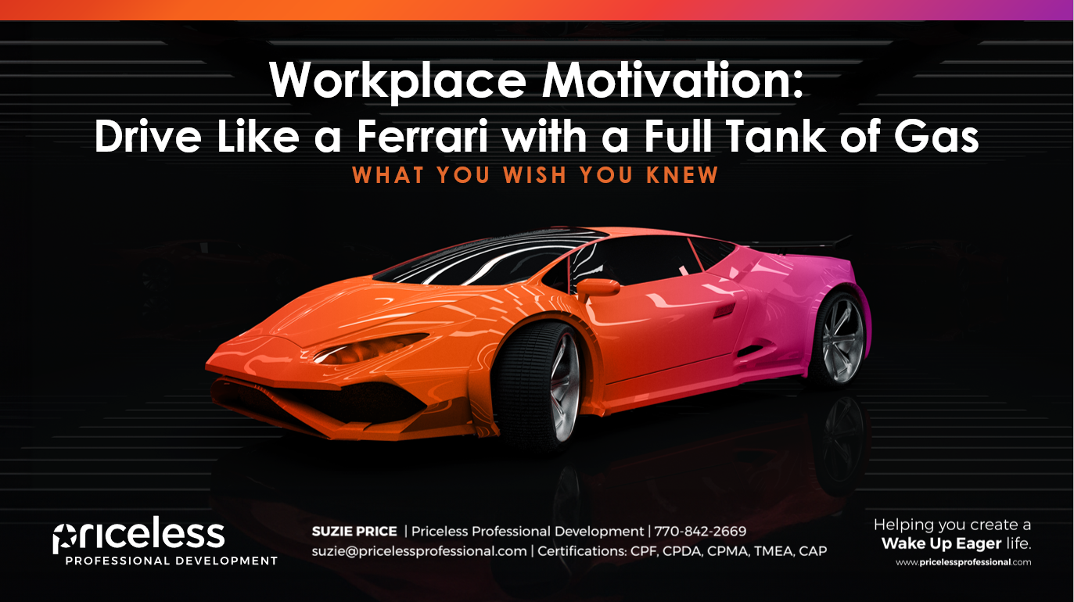

Slide 2


www.wakeupeagerworkforce.com
www.pricelessprofessional.com/review

Slide 3
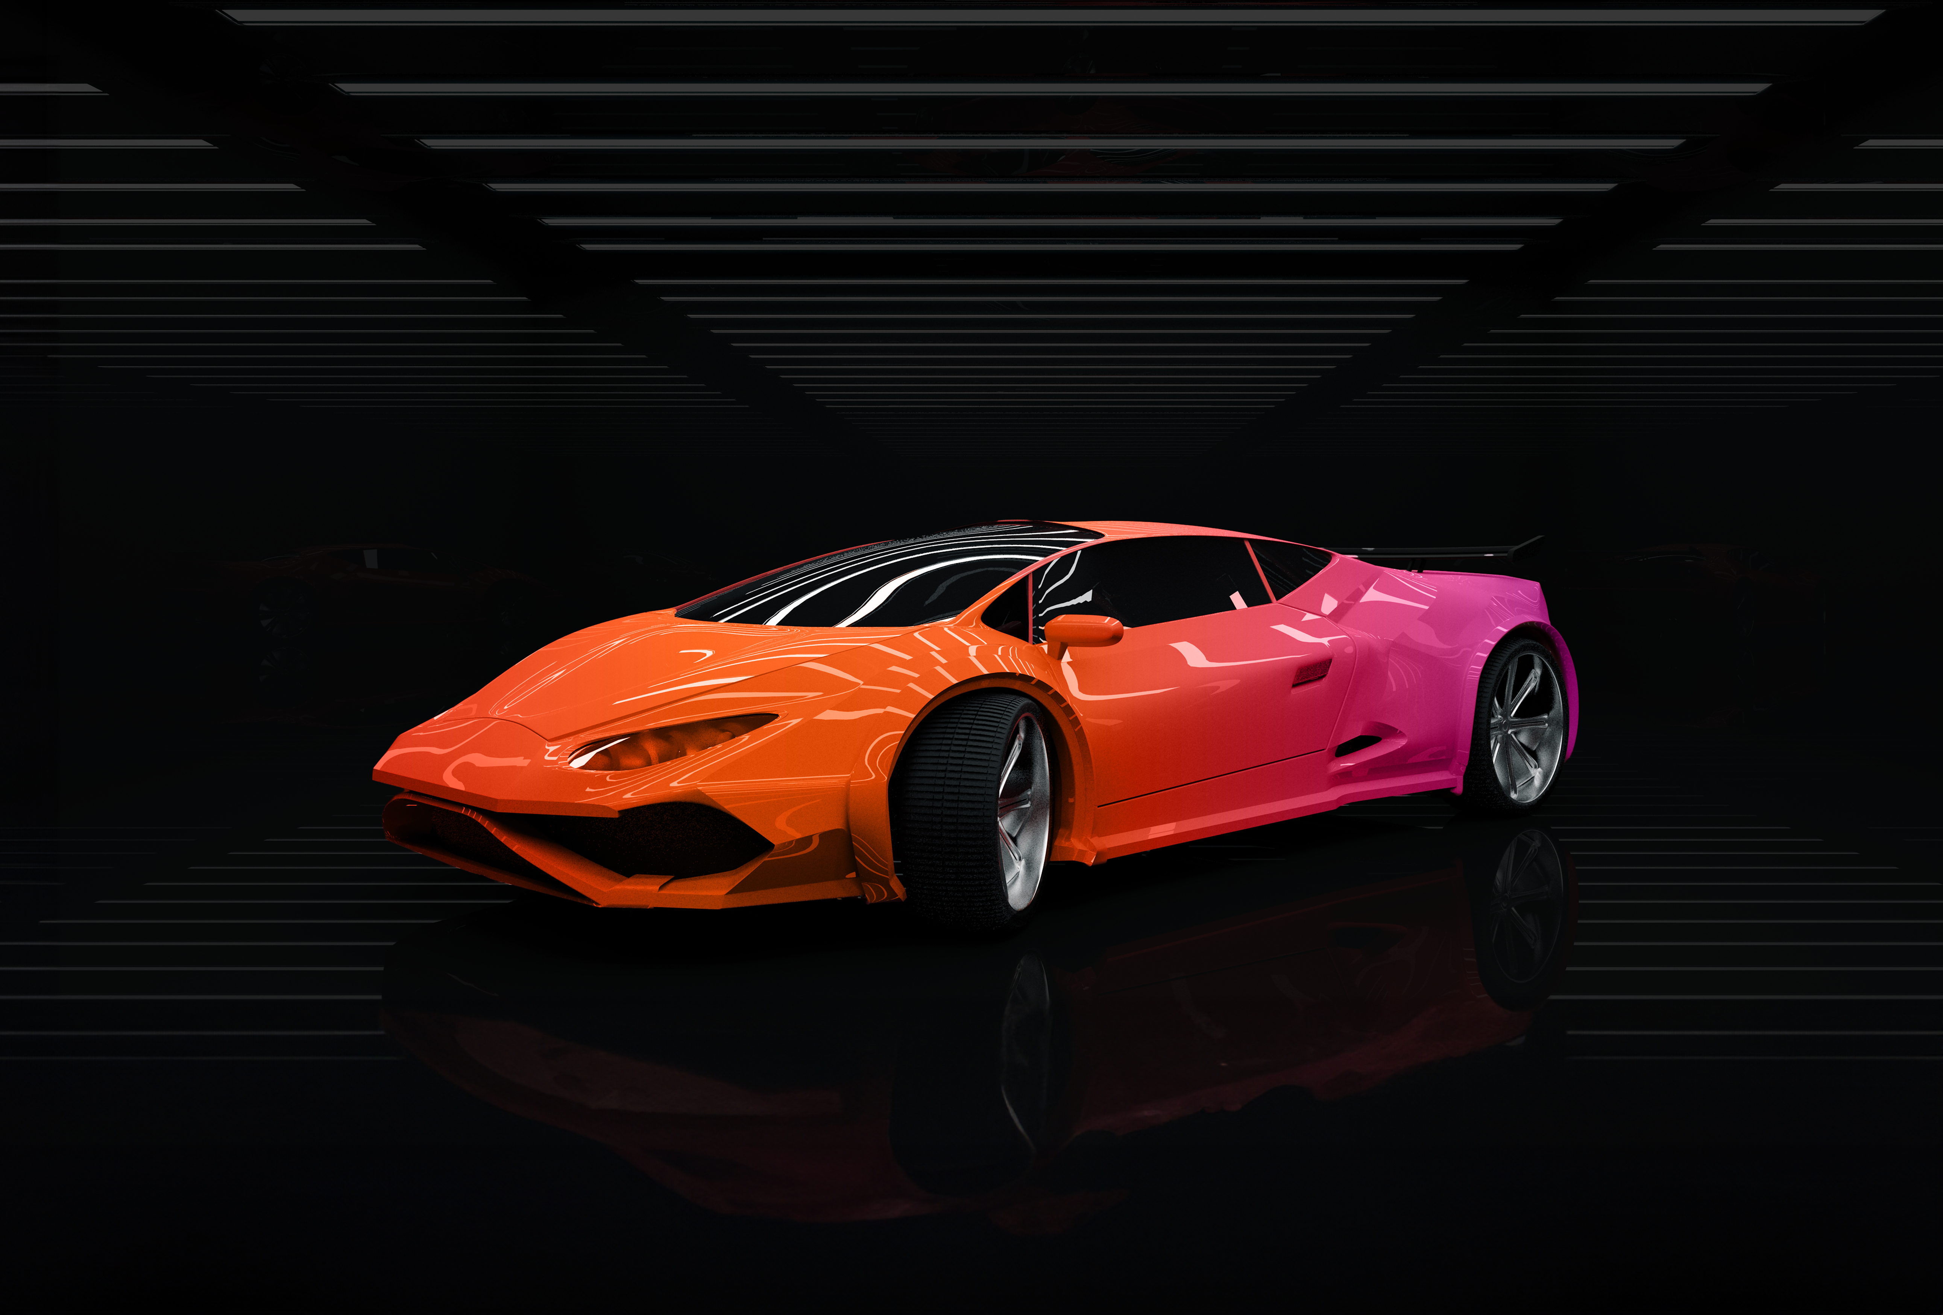

Workplace Motivation:
Drive Like You Have the Keys to a
Ferrari with a Full Tank of Gas
WHAT YOU WISH YOU KNEW
Episode 92
www.pricelessprofessional.com/ferrari

Slide 4
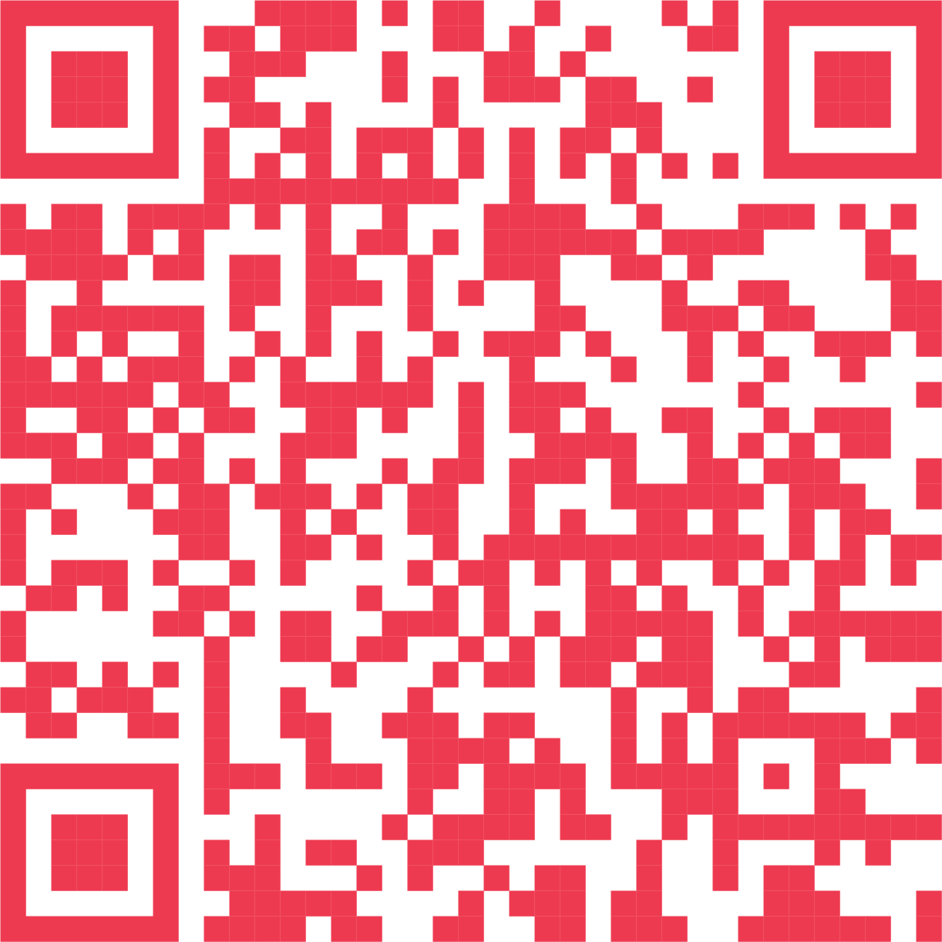
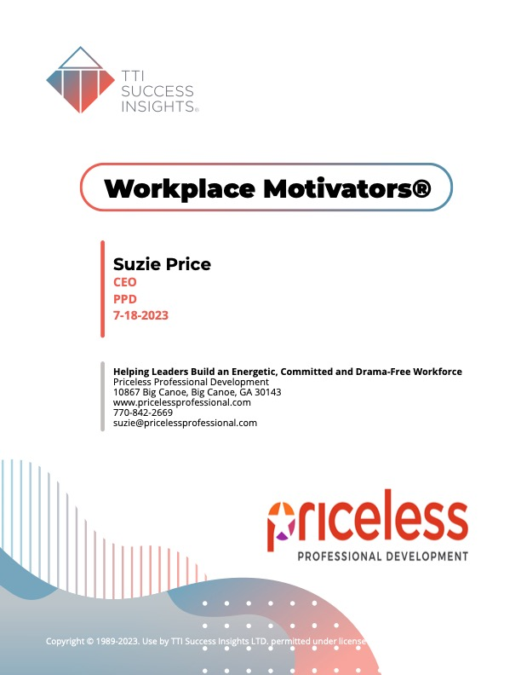
Complete the Workplace Motivators Assessment
A robust tool for measuring a person’s top interests and drivers.
www.motivatorsppd.com
.

Slide 5


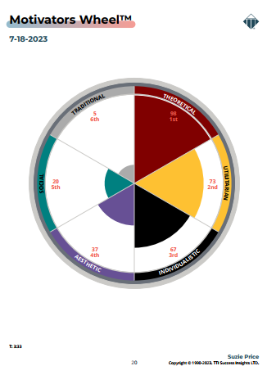

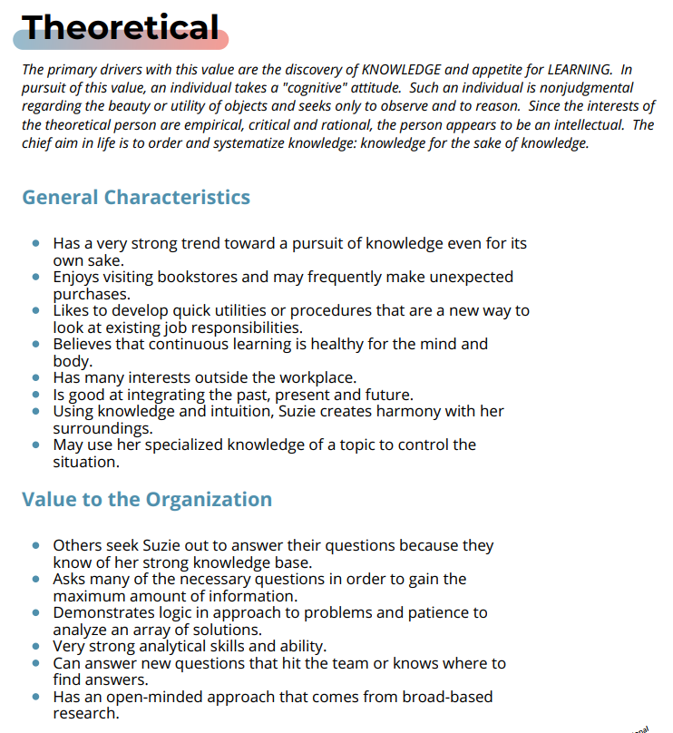


COMMON FEEDBACK
Workplace Motivators Assessment
“This makes sense. I’ve always cared about this.”
“I now know what I need to do more of in my free time and what projects I’m going to jockey for in the future.”
“My Assessment has helped me make sense of that job I struggled in… and why I wanted to change jobs!”
“Now I know why Jane and I disagree on so many things! I know what I need to do to make things better.”
www.motivatorsppd.com

Slide 6
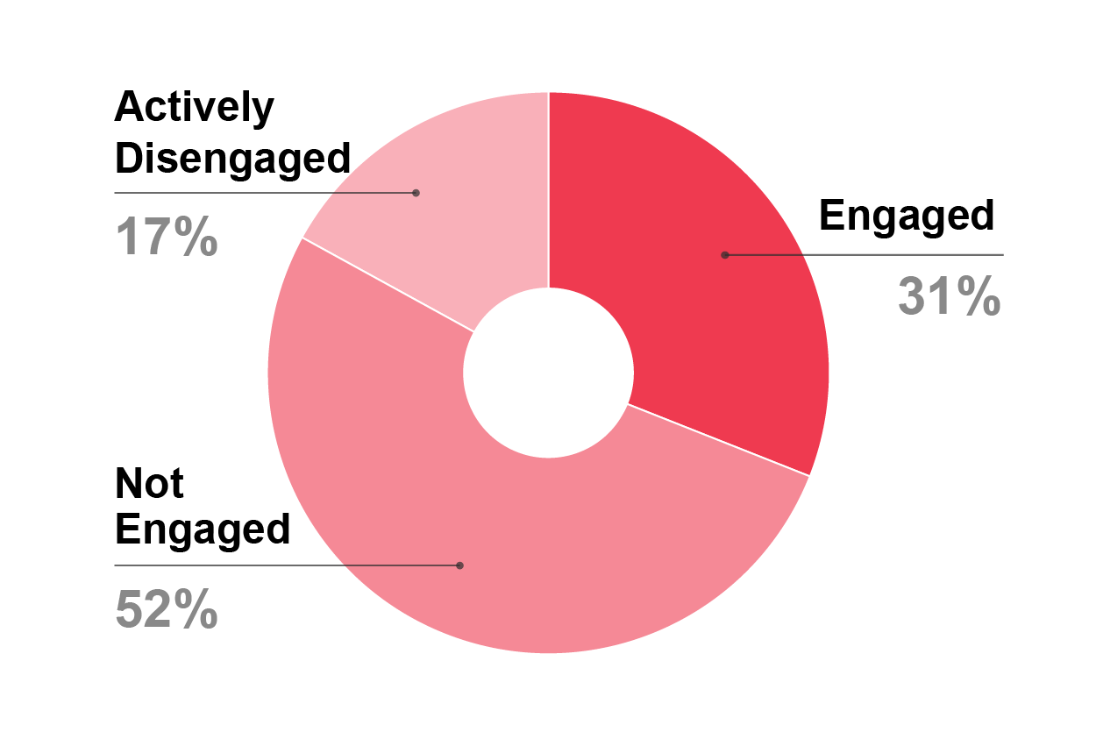
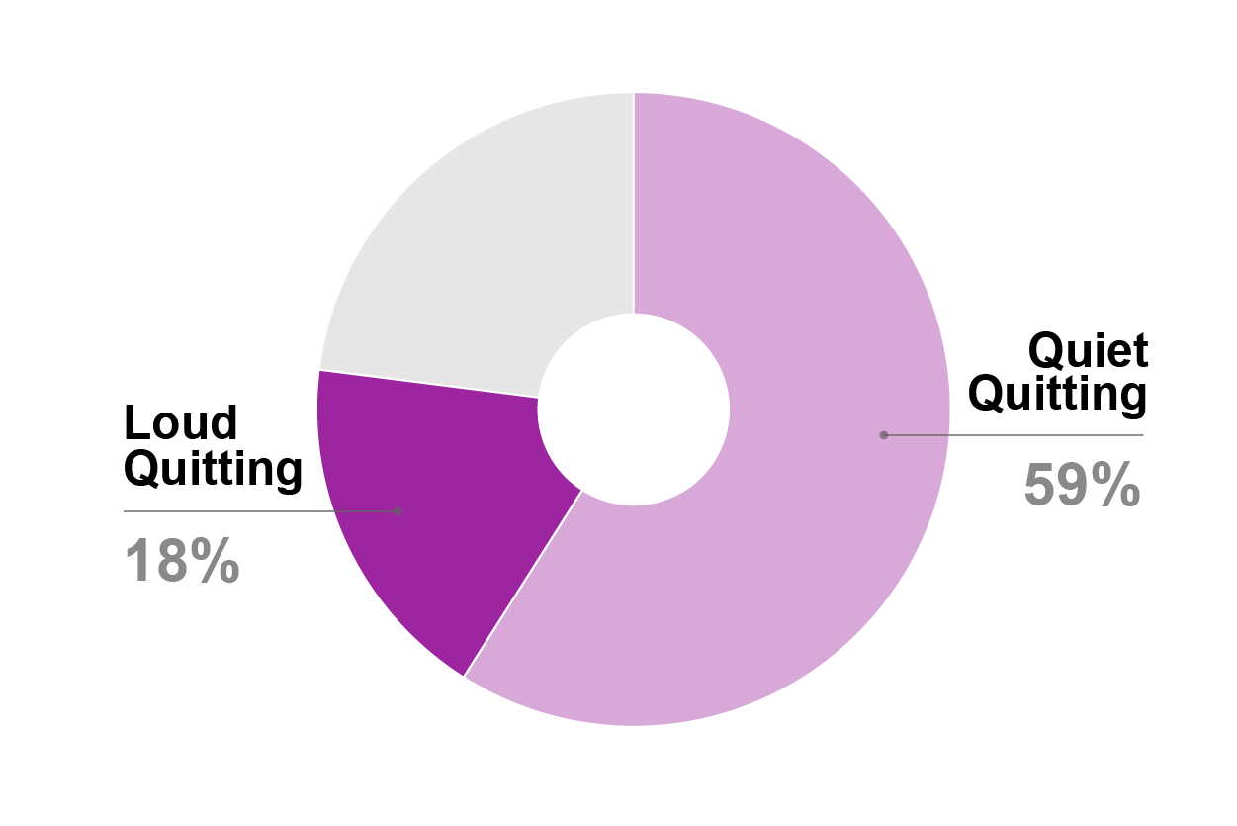
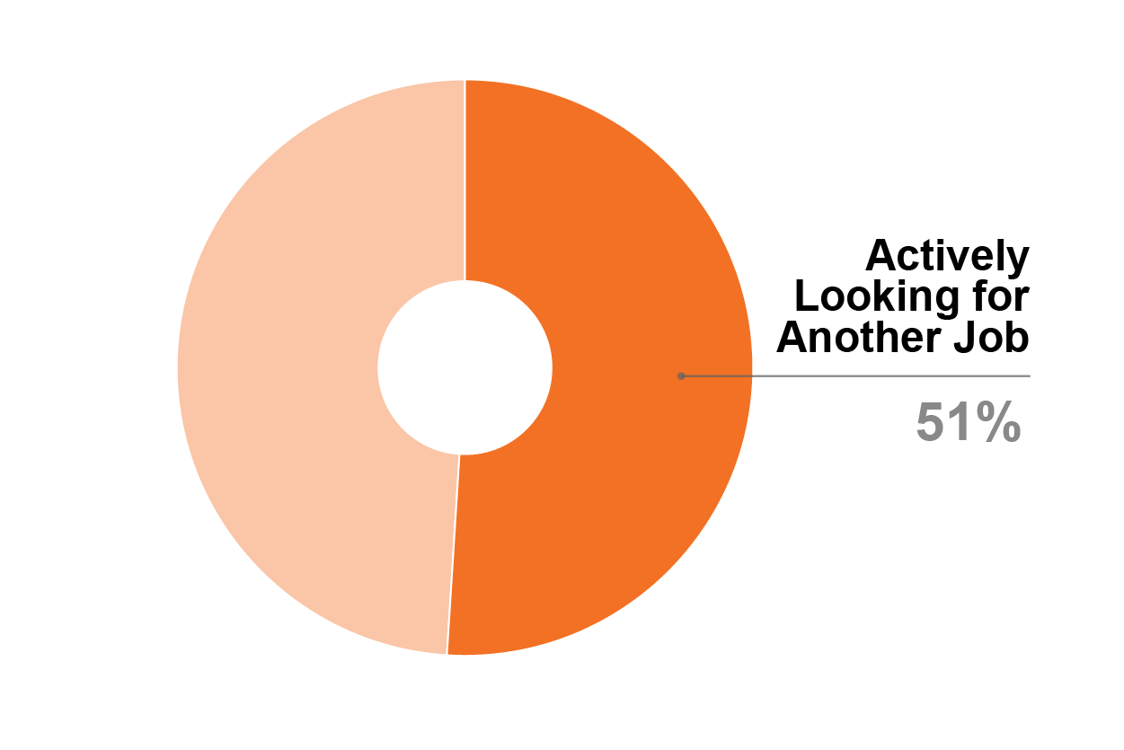
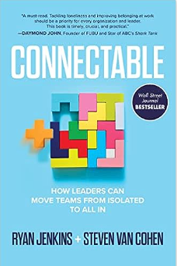

The State of Motivation and Engagement Today
IT’S A MESS!
2022 Research
Remote & Hybrid Workers | Effective Management | Creating High Engagement
✓ Higher Engagement ✓ Higher Stress | ✓ Starts with Meaningful Conversation | ✓ Adopt practices of best-run organizations that have 72% engagement.
Takeaway: What people experience in their everyday work — their feelings of involvement and enthusiasm — matter more in reducing stress. No location can fix poor management. | Takeaway: Weekly one-on-one feedback meetings (15-30 minutes) with employees focused on Recognition, Collaboration, Goals and Priorities, and Strengths. | Takeaway: Consider the impact on organizations and society. Record high productivity, customer retention and growth, better employee retention, and significantly reduced stress.

Slide 7
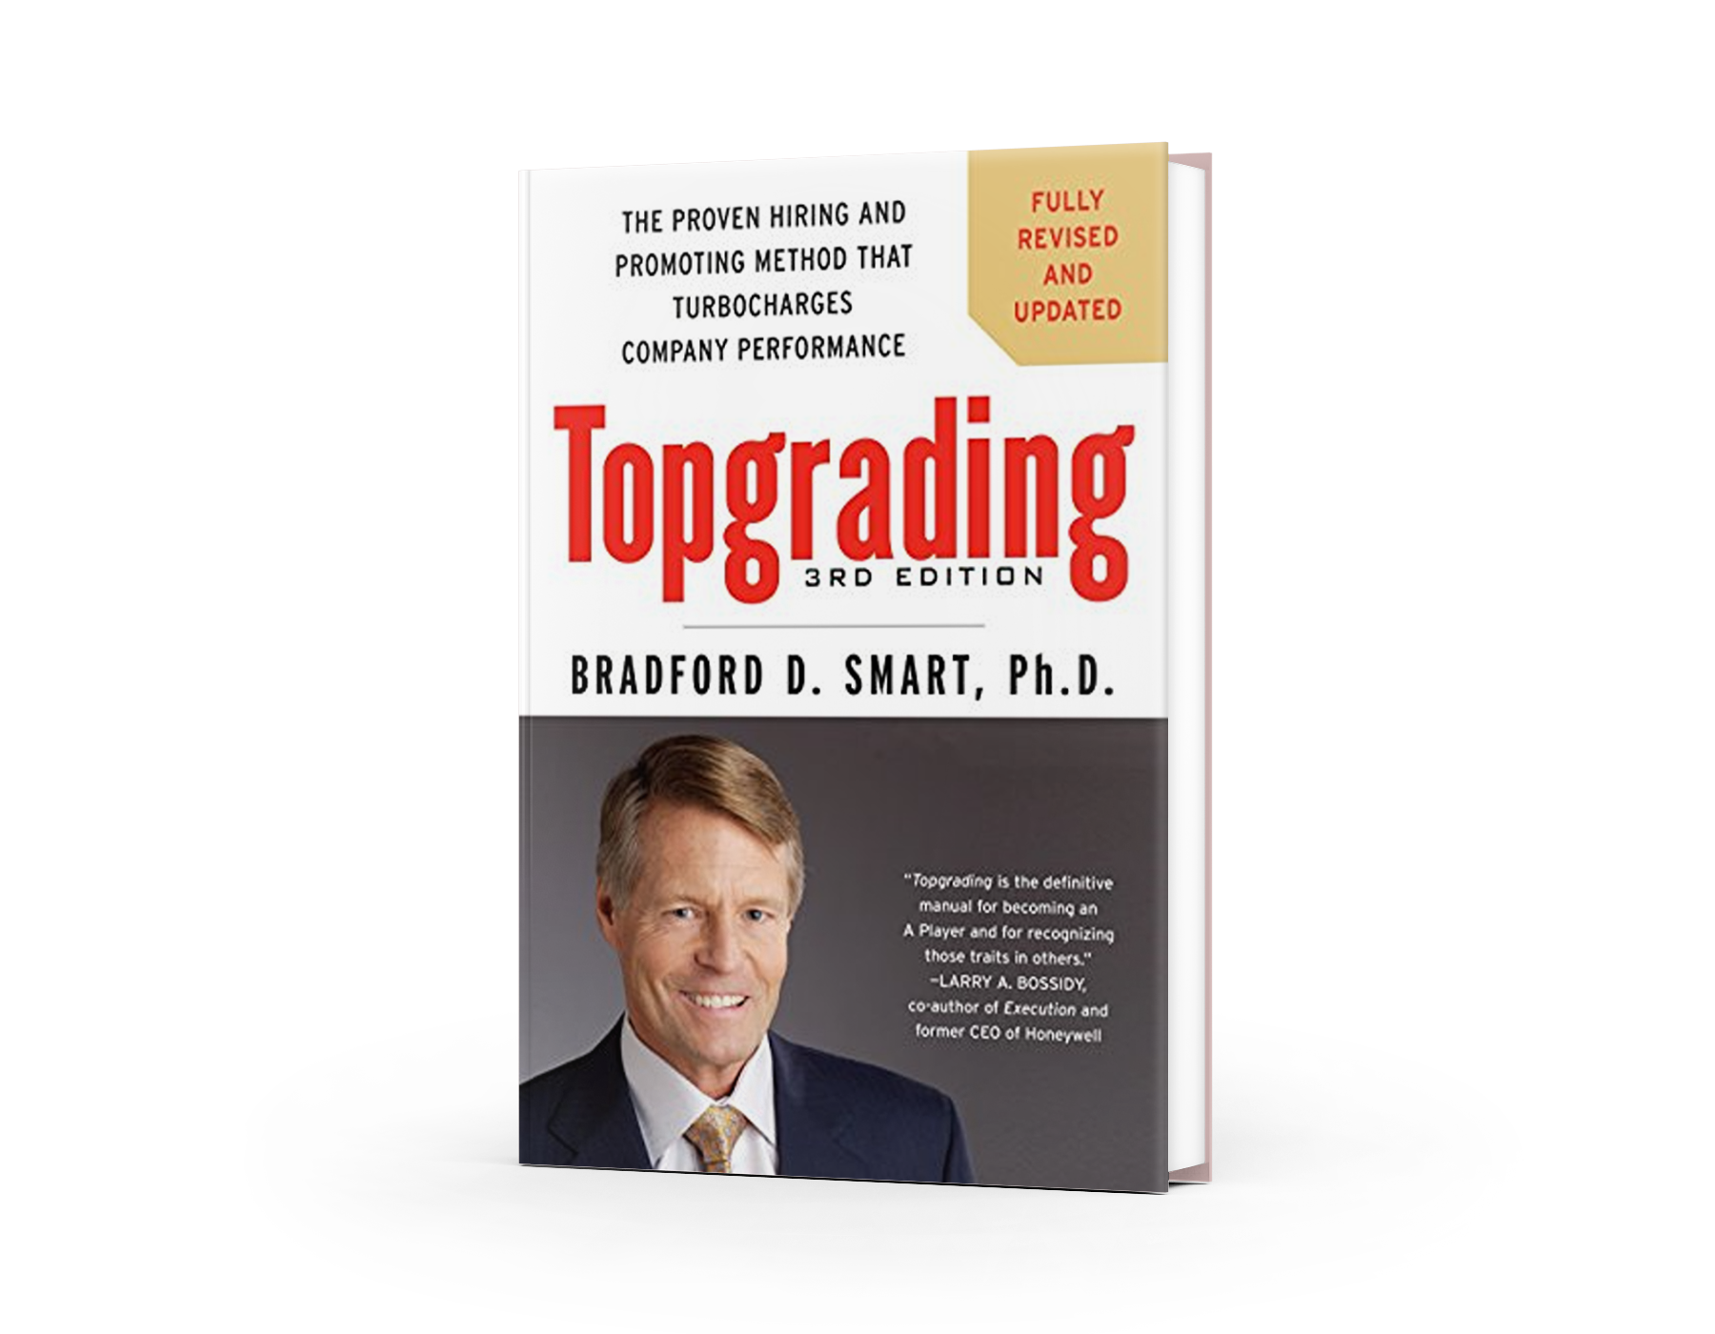
Calculating the Cost of Turnover
SAMPLE TEAM: Average Employee Base Salary = $50,000
A | Employees on Team | 25
B | Annual Turnover | 2 people
C | CALCULATE 1.5 x Average Salary = Cost of Turnover PER PERSON | $75,000
 | ANNUAL COST OF TURNOVER = (B X C) | $150,000
Notes:
2 quit, 3 you let go….

Slide 8
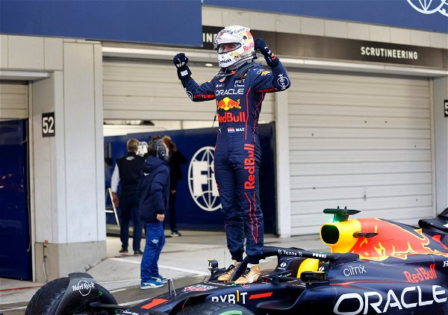
You Hired A Champion!
Notes:
Reduce risk… Get away from:
“Anyone can be trained to do any job.”
“With enough training & try hard enough any one can excel…”
People bring who they are to the job – and who they are is not only their background and experience, but their natural style, strengths and motivators.

Slide 9
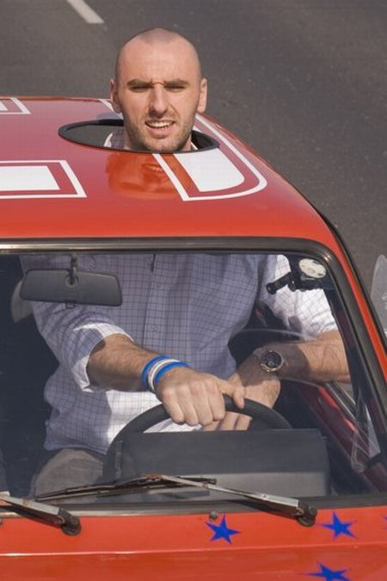
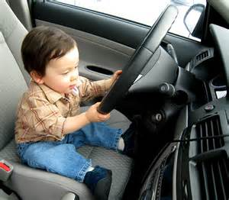
Three Work Modes…
“I look good, but I don't work.”
“I mean to do good work,
but I can be unreliable and
inconsistent.”
“I get it done no matter what!”

Slide 10

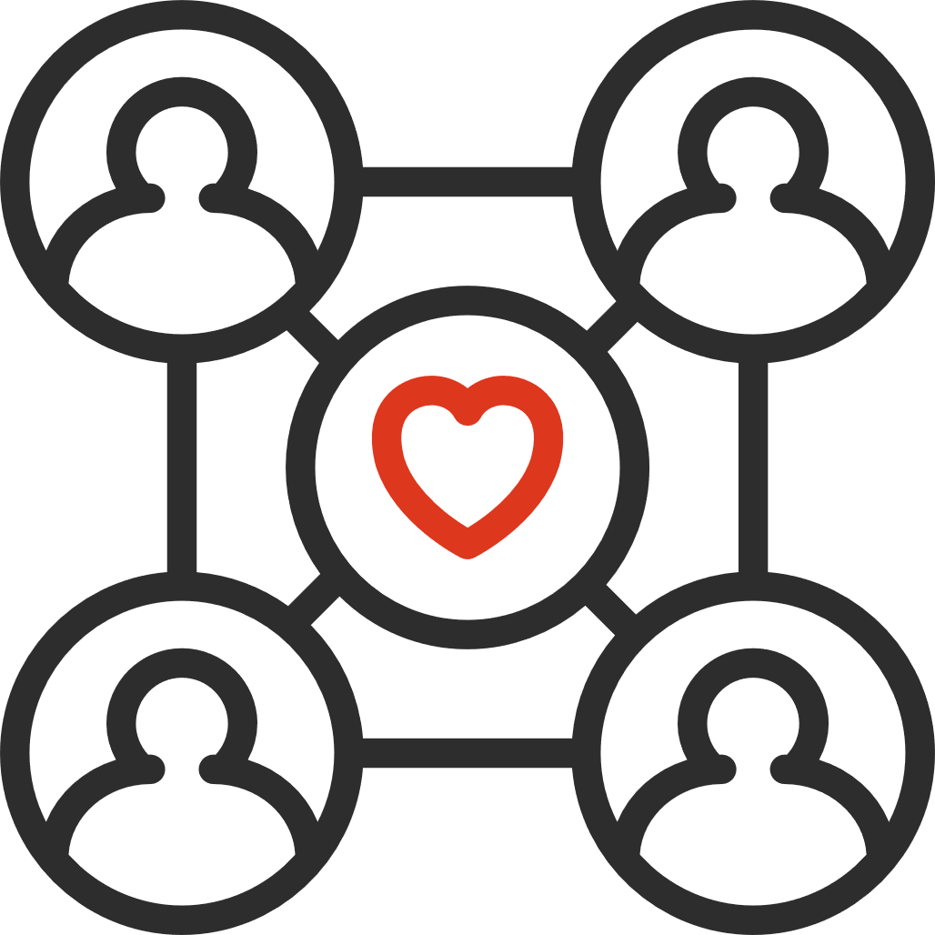

“What determines long-term work motivation and job ethic?”
Fit for the job.
How closely does who they are match what the job needs? Is this work something they can do and want to do?***
Their relationships and connection with their leader and the company.
Do they feel as though the company cares about them, and do they care about this company?***
Past habits formed over the years.
Requires much effort and focus by the person to change.

Slide 11
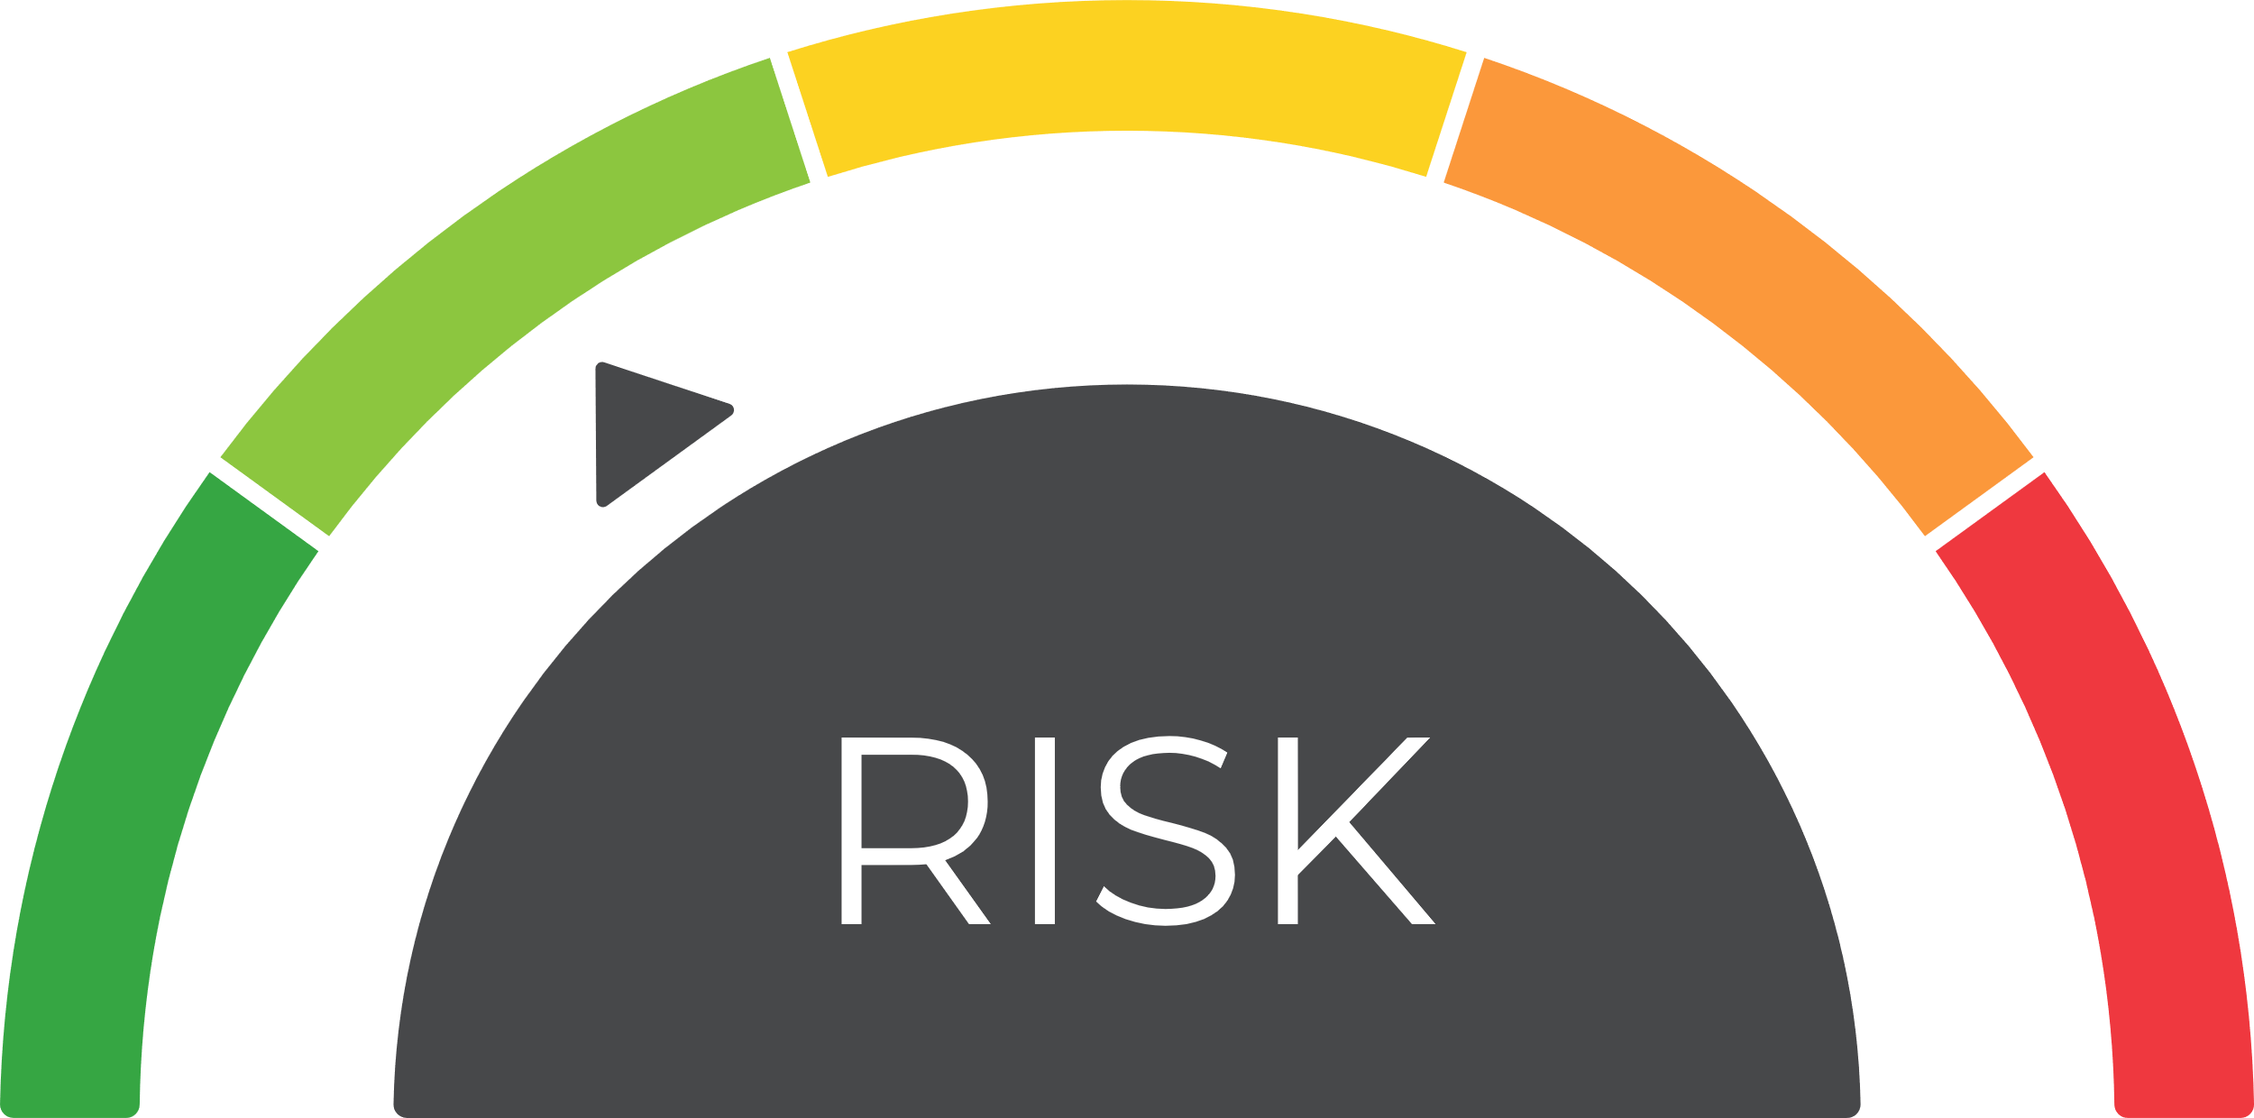
Reduce
The Risk of Turnover and Low Engagement
Notes:
Reduce risk… Get away from:
“Anyone can be trained to do any job.”
“With enough training & try hard enough any one can excel…”
People bring who they are to the job – and who they are is not only their background and experience, but their natural style, strengths and motivators.

Slide 12

The Key to
the Ferrari…

Slide 13
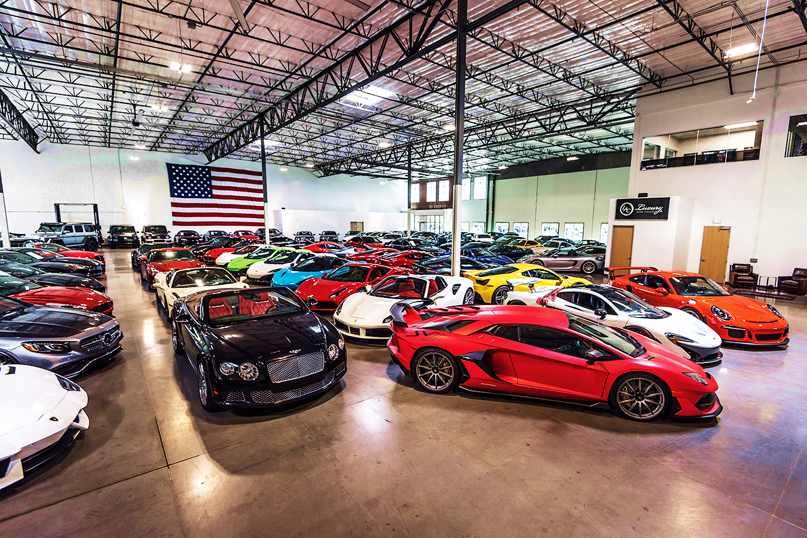
WHAT WILL YOU DO?
You just inherited a $5M car collection…
What are your first thoughts?
What would you do with it?
Notes:
Note: this exercise doesn’t have a worksheet – discussion
Objective: To give participants an example of how the Driving Forces may play out in am imaginary scenario
Facilitation:
Ask participants, “If you inherited a $5 million dollar art collection: What are your first thoughts? What would you do with it?”
Have them share with a partner and then discuss as a large group
Answer: most likely one of your primary Drivers Ex. Sell it/Resourceful, Study it/Intellectual, give to a museum/Harmonious.
Transition: Now let’s discuss some of the benefits of understanding Driving Forces

Slide 14
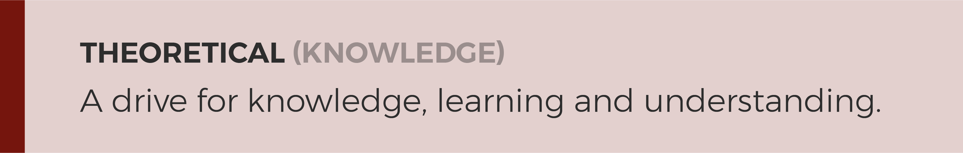
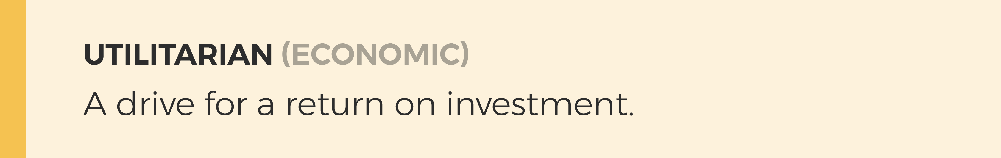
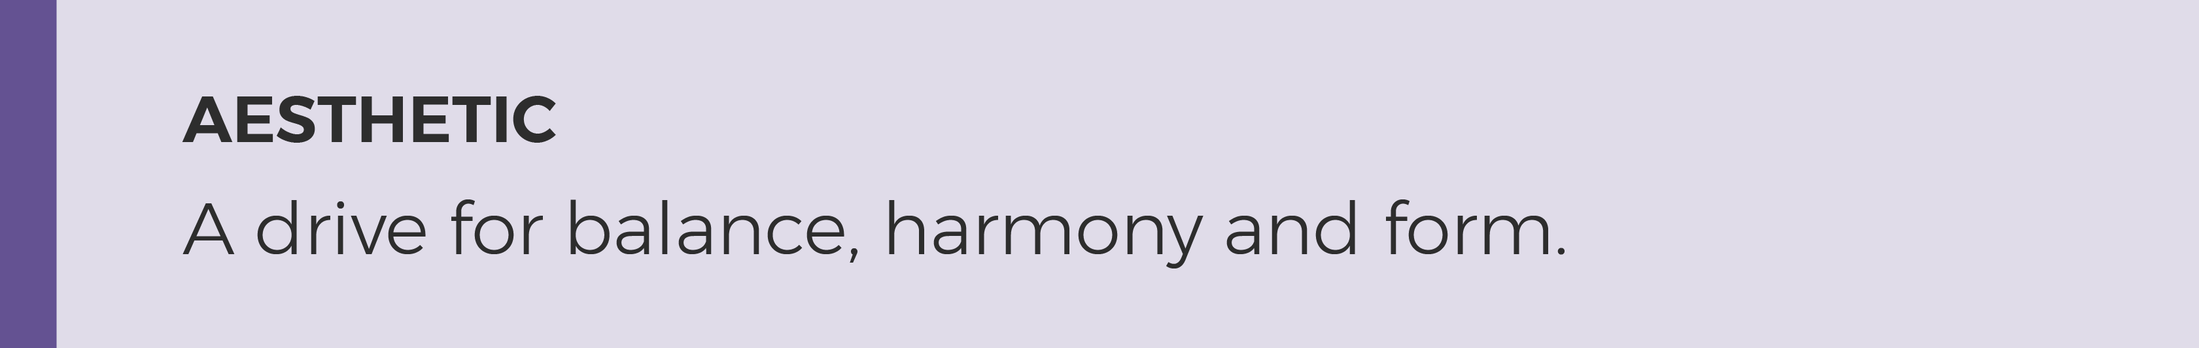
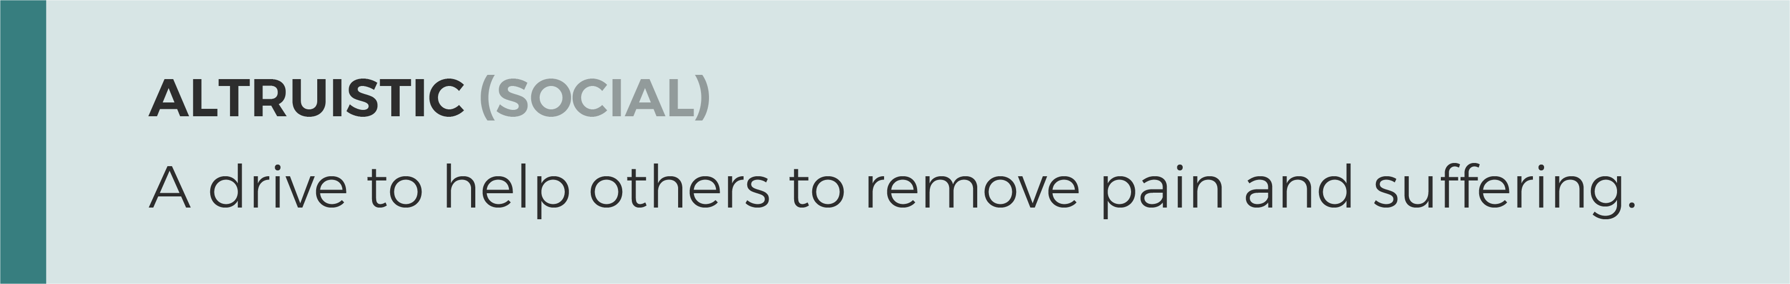

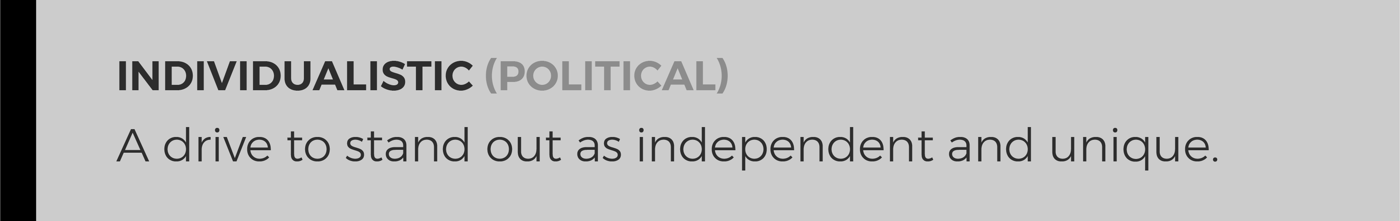
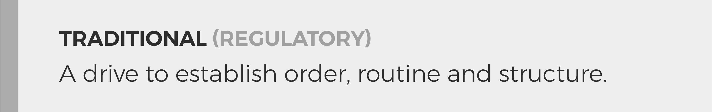
Our top motivators reveal what we are most interested in and how we want to spend our time.
Notes:
Objective: To understand what the Driving Forces measure and how they can change.
Facilitation:
Review the list.
Ask participants, “If you inherited a 50 million dollar art collection, what would you do with it”?
Answer: most likely one of your primary Drivers Ex. Sell it/Resourceful, Study it/Intellectual, give to a museum/Harmonious.
Transition: Now that we understand the Driving Forces a little more, let’s set some session goals.

Slide 15

So, what are Workplace Motivators?
The “Why” of our actions
Drives our choices and decisions
Creates engagement when fulfilled
What is automatically important to you
How you judge people or situations
The arena in which you like to communicate (‘your peeps’)

Slide 16
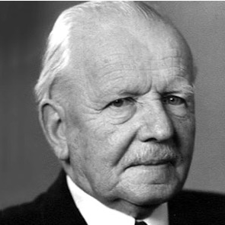

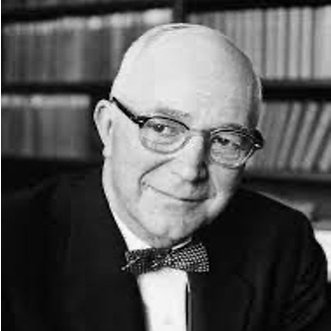

A Little History
  Assessment Creator
  Developed and validated the Workplace Motivators Assessment - 1998.
  EEOC Compliant and OFCCP Compliant
Eduard Spranger
  Author, “Types of Men” — 1928
  German psychologist
  Identified the six categories, called attitudes
Gordon Allport
  Psychologist Gordon Allport built on Spranger's work to develop the Study of Values assessment in1931.
  Certified in these tools since 2006.
  Reviewed over 25,000 assessments
  Top 20 Value Added Partner with TTI Success Insights
Notes:
Objective: To understand what the Driving Forces measure and how they can change.
Facilitation:
Review the list.
Ask participants, “If you inherited a 50 million dollar art collection, what would you do with it”?
Answer: most likely one of your primary Drivers Ex. Sell it/Resourceful, Study it/Intellectual, give to a museum/Harmonious.
Transition: Now that we understand the Driving Forces a little more, let’s set some session goals.

Slide 17

A Look at Your Motivators
Your #1, #2, (MOST) and #6 (LEAST) are what drives you to act
Not “good or bad” or “right or wrong”
Not about ability, but are about INTEREST
They may reorder as life circumstances change
They reveal what stresses us out and what we can tend to overdo
With awareness, you can manage stress and what you may overdo

Slide 18

INHERITANCE: “I’m going to learn more about cars!”
Dis-satisfier | May Overdo
Inability to discover truth, understanding and knowing about a topic. | Practical matters can be neglected and ignored.
Paid & Volunteer Work | Famous
Science, R&D, Astronomy, Engineering, Mathematics, Philosophy, Journalism, Aerospace, Think Tanks, Psychology, STEM, Anthropology, Political Science, AI, Virtual Reality, Professor Race Team: Speed, Engine, and Tech Expert | Albert Einstein, Marie Curie, George Washington Carver, Mayim Bialik, Nancy Drew,

Slide 19
INHERITANCE: “I’ll keep the cars that will grow in value and sell the rest!”
Dis-satisfier | May Overdo
Investments with little of no return. | May become a workaholic, willing to give but will expect something in return.
Paid & Volunteer Work | Famous
Economics, Sales, Finance, Supply Chain, Medicine & Dentistry, Consulting, Accounting, Engineering, Real Estate, Construction, Trade Schools, Business Management, Project Coordination, Investment Banking Race Team: Sell Sponsorships, Business Manager | Warren Buffett, Mary Barra (CEO GM), Jay-Z, Sheryl Sandberg.

Slide 20
INHERITANCE: “I’ll keep the prettiest cars and photograph them!”
Dis-satisfier | May Overdo
Chaos and disturbance around them and a lack of balance and rest. | May function outside of reality and struggle with everyday reality.
Paid & Volunteer Work | Famous
Graphic Design, Marketing/Advertising, Event Planning, Culinary Arts, Architect, Urban Planning, Environmental Design, Interior Designer, Photographer, Artist, Horticulture, Landscaping Race Team: Look of Car, Website Design & Social Media | Walt Disney, Tyler Perry, Vera Wang, Frank Lloyd Wright, Steve Jobs, Jackie Onassis,

Slide 21
INHERITANCE: “I’ll sell them and give the money to my favorite charity!”
Dis-satisfier | May Overdo
Decisions that are insensitive to people. | May create lose/win relationships, focusing only on the benefits to others.
Paid & Volunteer Work | Famous
Non-Profit, Education, Healthcare and Social Services, Medicine, Social Work, Counseling/ Therapy, Veterinarian, Public Policy, Fireman, Police Officer, Coaching Race Team: Support, Coach Driver, Handle Charity Events, Sports Psychologist | Mother Teresa, Sigmund Freud, Ben Carson, Maya Angelou, Dala Lamai, Princess Diana,

Slide 22
INHERITANCE: “I’ll get the cars published in car
magazines and will take up racing as a hobby.”
Dis-satisfier | May Overdo
Lack of respect for position and chain of command. | A desire for power can control all focus and interest, and position oneself over others.
Paid & Volunteer Work | Famous
Entrepreneurship, Political Science, Public Speaker, Litigation, Business, Broadcasting/Communications, Venture Capitalism, Professional Sports, Leadership, Sales, Trade Jobs, Outdoor or Adventure Jobs Race Team: Drive, Team Owner, Spokesperson | Sara Blakely (SPANX), Henry Ford, Sheila Johnson (co-founder B.E.T.), Tom Brady, Tiger Woods,

Slide 23
INHERITANCE: “I’ll organize everything, check the insurance, and review laws and regulations.”
Dis-satisfier | May Overdo
Lack of directions, order, and structure. | Close-minded and judgmental toward other viewpoints, being too rigid.
Paid & Volunteer Work | Famous
Government, Education, Quality Control, Insurance, Religious Roles, Military, Banking, Finance, Cultural Studies, Activism, Law Enforcement, Industrial/ Trade Jobs, Funeral Services Race Team: CFO, Race, and Car Rules | Golda Meir, General George S. Patton, Lieutenant Anita Van Buren on Law & Order, Tim Tebow, Rosa Parks, Billy Graham

Slide 24
Workplace Motivators, in a practical way, provide a common language for understanding and discussing differences.
It helps us understand and benefit from the
value of different opinions, which also helps us understand the value of every relationship.

Slide 25

Nathan and His Team
Economic
& Political Leader
Notes:
Ops team – work together for 5-10 years, qualified, liked each other – CEO, “Appreciate… Sometimes they drive me crazyTBTU - Understanding each others genius. Different. Not judging someone for being different or not like me. …” One-to-one – “Appreciate… Sometimes Jim drives us crazy…”

Slide 26
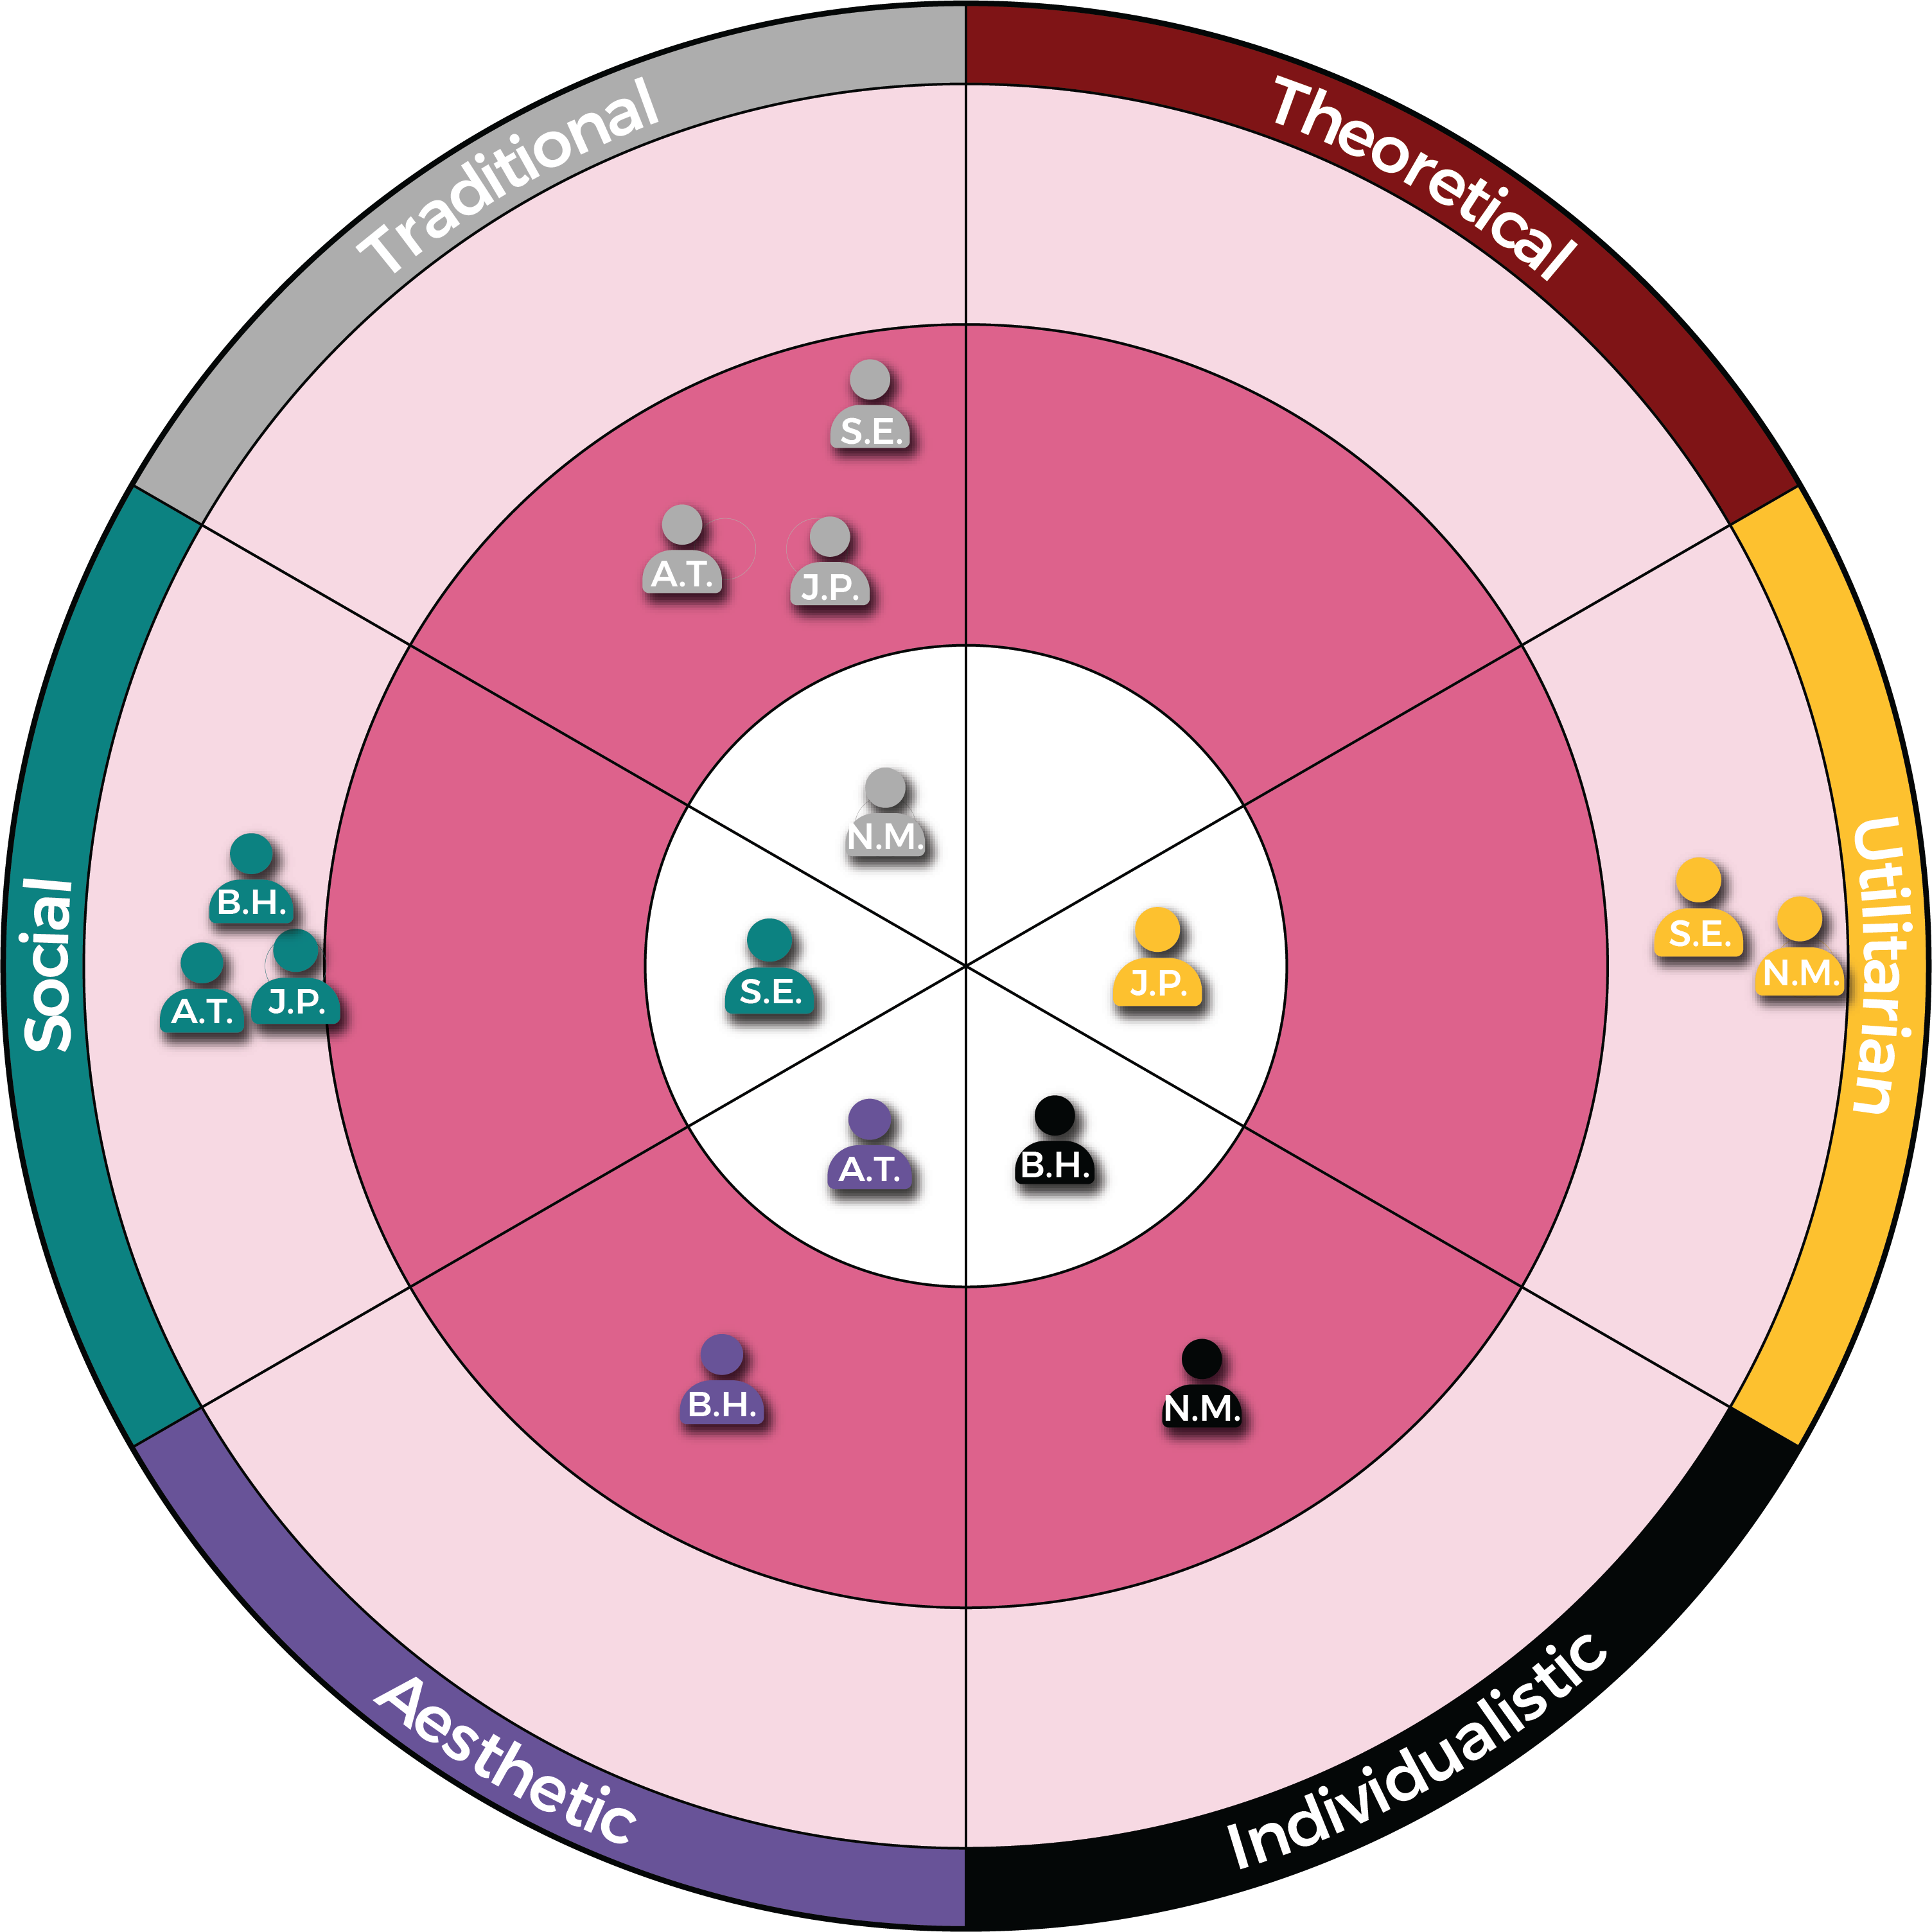
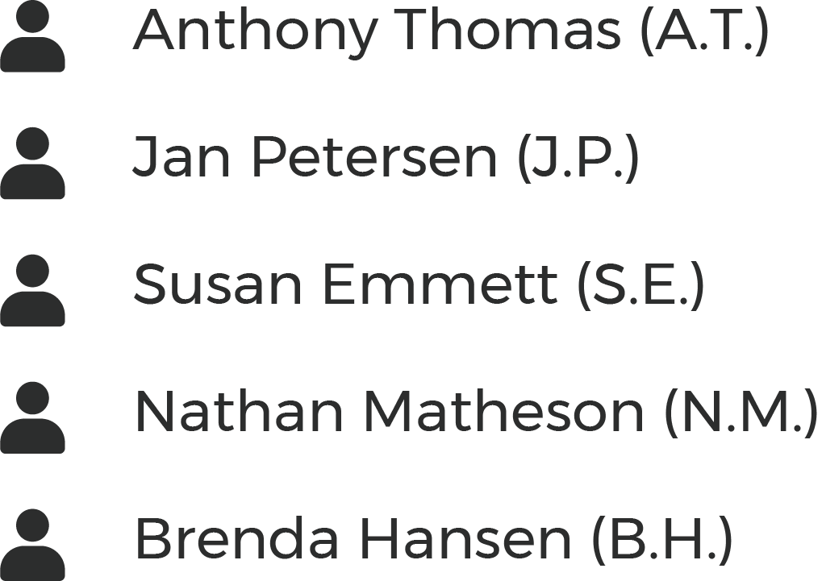
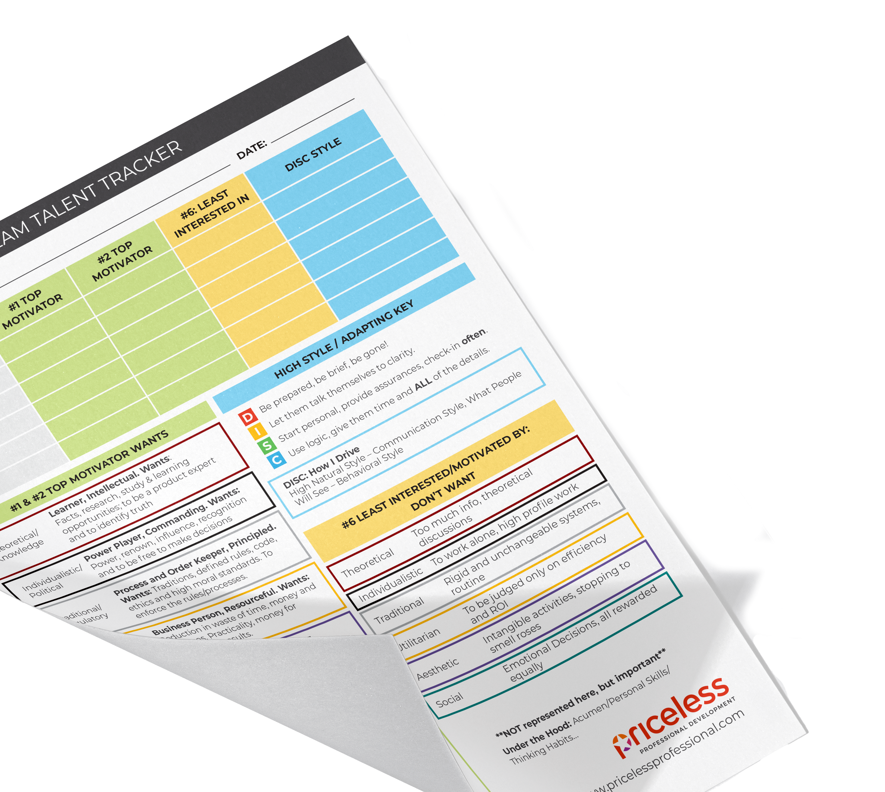
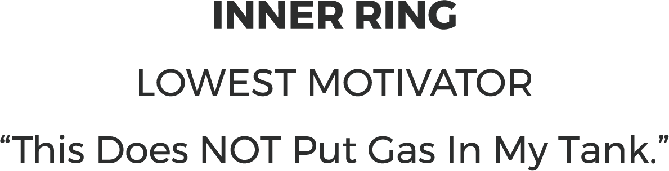
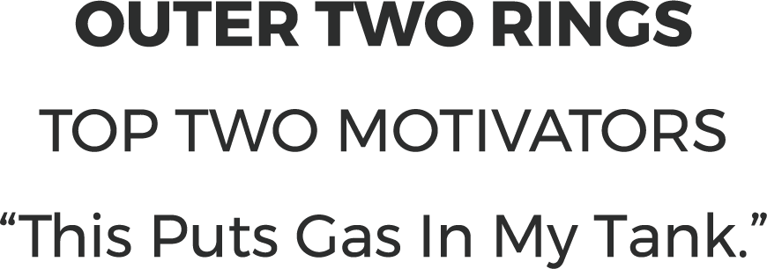

Slide 27
Nathan and His Team
Economic
& Political Leader
Regulatory
Leader
Results
Leader
Altruistic
Leader
Knowledge
Leader
Notes:
Ops team – work together for 5-10 years, qualified, liked each other – CEO, “Appreciate… Sometimes they drive me crazyTBTU - Understanding each others genius. Different. Not judging someone for being different or not like me. …” One-to-one – “Appreciate… Sometimes Jim drives us crazy…”

Slide 28
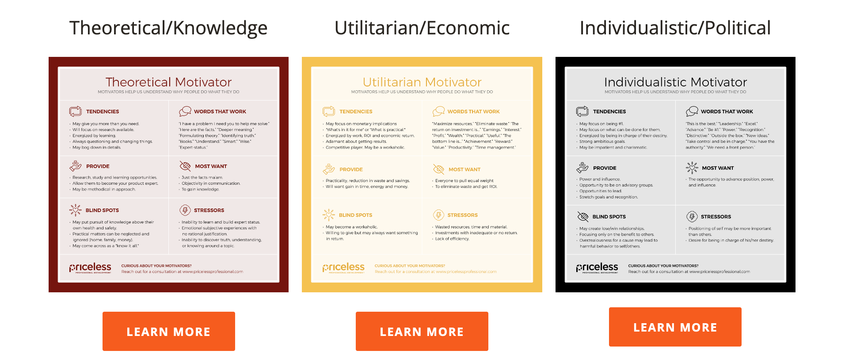
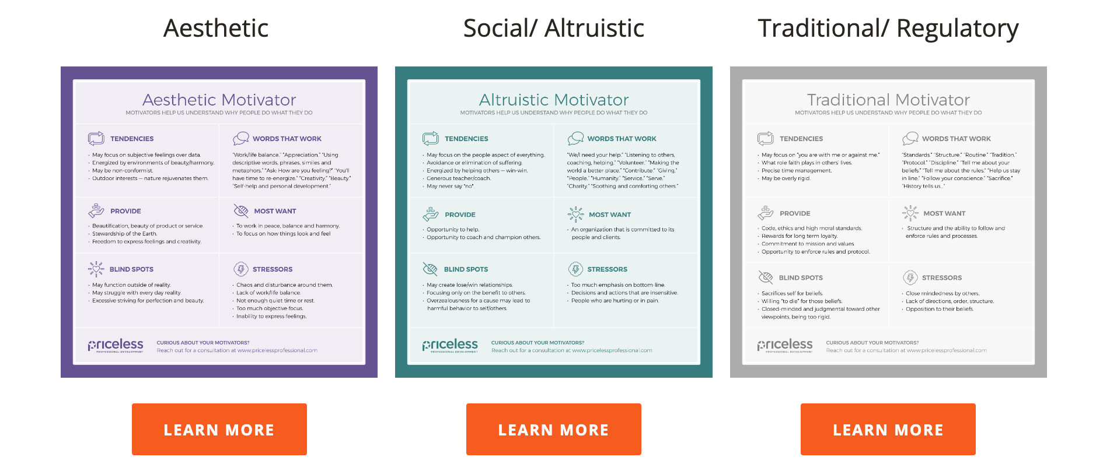
WORKPLACE MOTIVATORS
Insights and Exercises for Teams
Employee’s Energizers and Exhausters: Team Members Review Energizers and Stressors; Determine – What You Want to Do More Of and What You Want to Delegate
Leader’s Delegation Proclamation: Review Teams Top Motivators; Reviews Tasks and Projects; Create Delegation Suggestions, Discuss with the Team
Resolving Conflict: Reviewing Each Person’s Viewpoint, Sharing Top Motivators, What Each Person Wants the Other Person to Understand, Discuss Potential Fixes
www.motivatorsppd.com

Slide 29
How to Get the Most from This Report
Use the Action Plan Worksheets to dive deeper into your results. Plan on sharing the Team Building Summary with your teammates. Have them share, too.
Use the Summary Memory Jogger card (found on www.motivatorsppd.com )to manage your energy and focus and better understand everyone you work and live with.
Page 19
Page 20
Pages 21-22

Slide 30
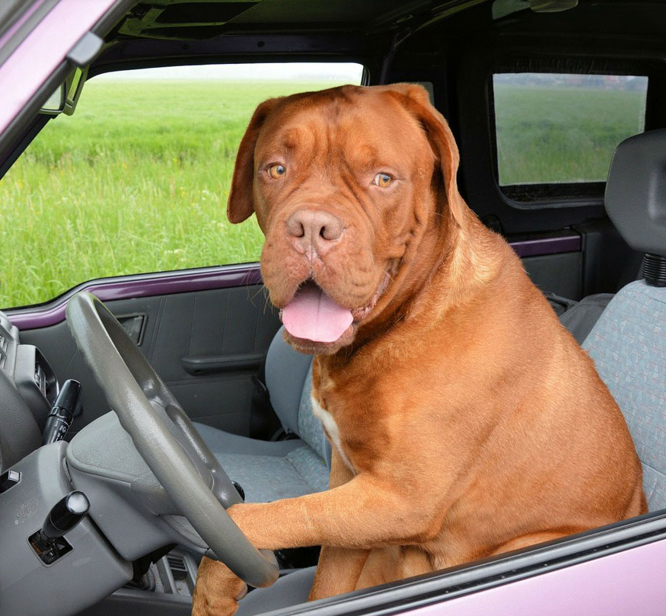
HIRING HELP
Some leaders think that with enough
training anyone can do the job…

Slide 31
Make sure the candidate’s ”Gas in the Tank” match the job’s rewards…

Slide 32
Chris is Director of Finance Champion!
Notes:
Reduce risk… Get away from:
“Anyone can be trained to do any job.”
“With enough training & try hard enough any one can excel…”
People bring who they are to the job – and who they are is not only their background and experience, but their natural style, strengths and motivators.

Slide 33
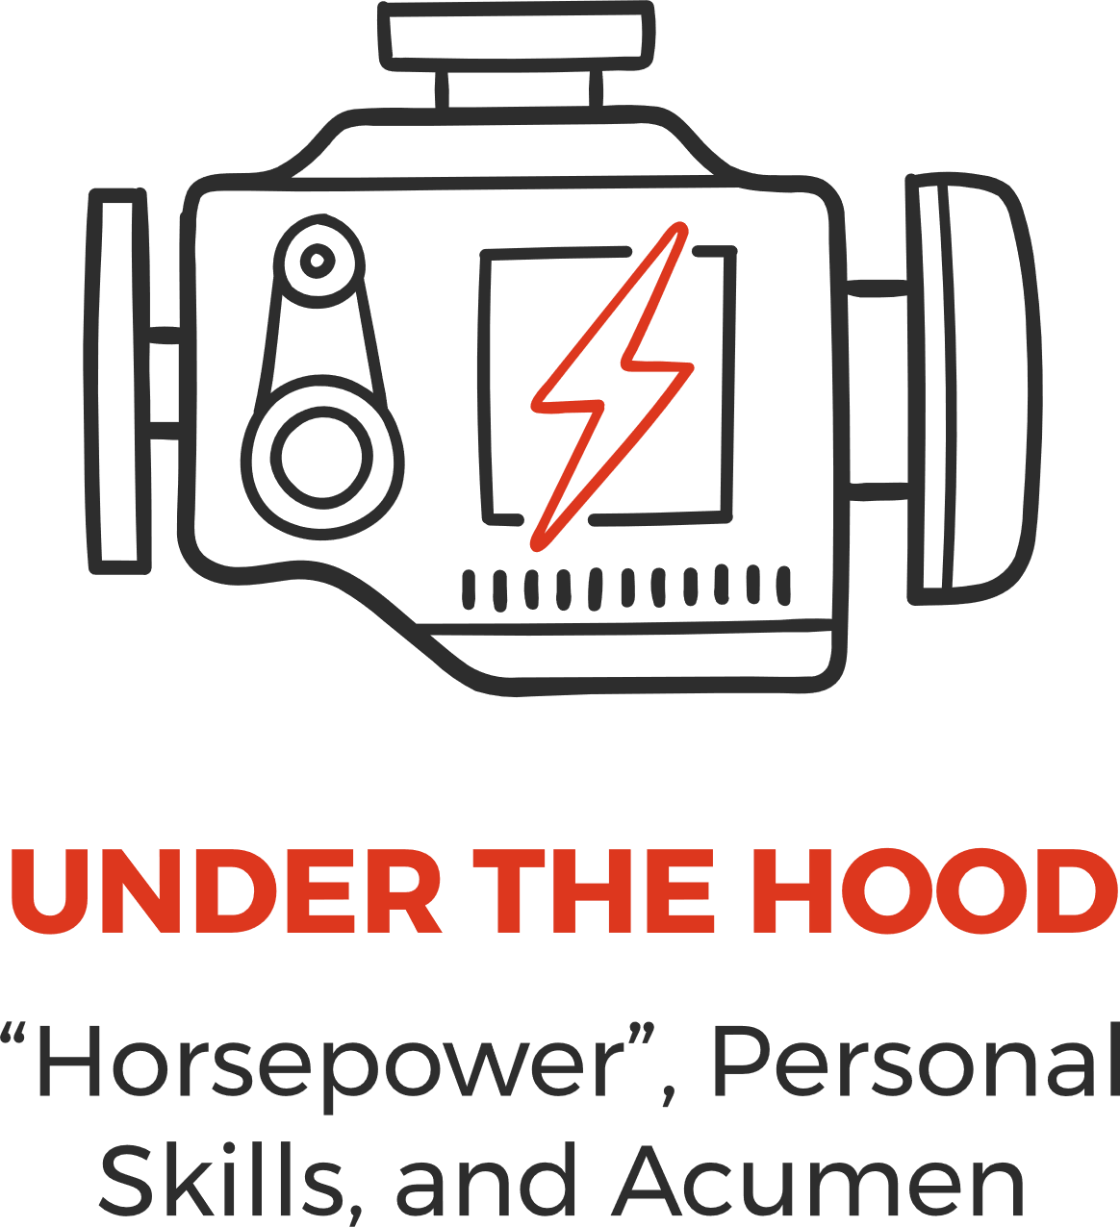
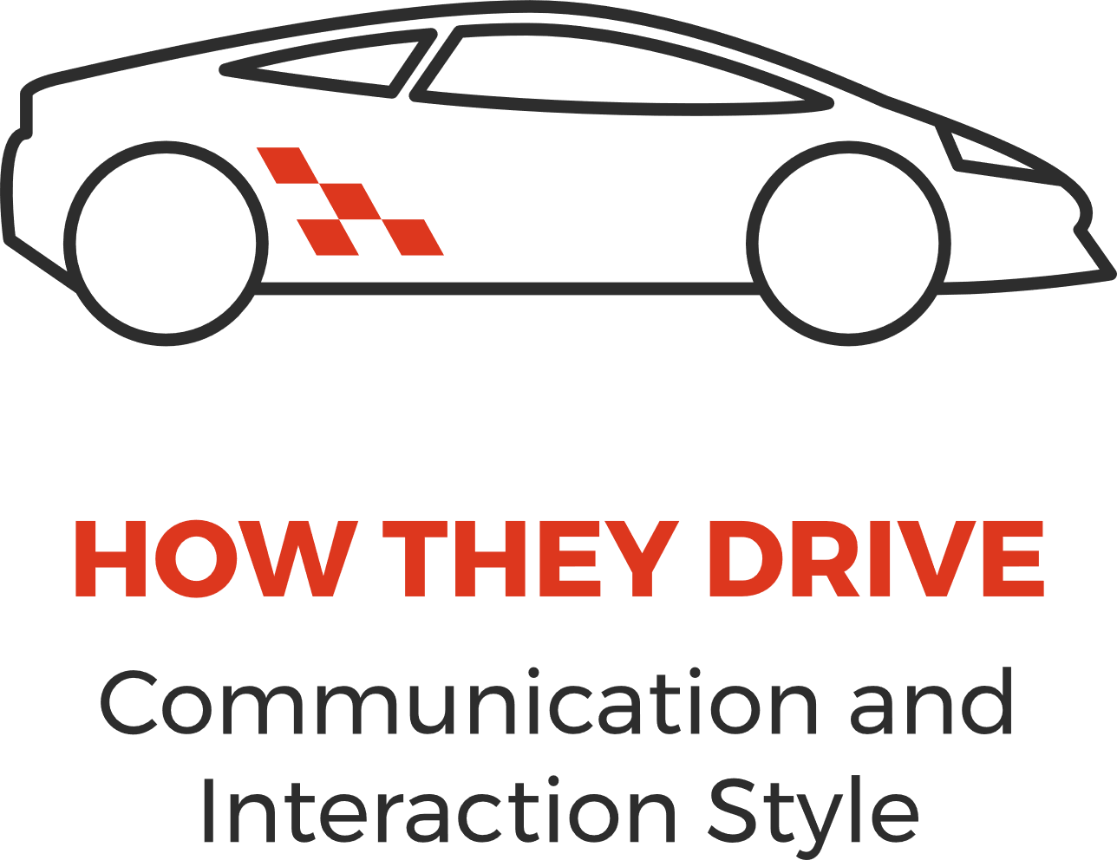

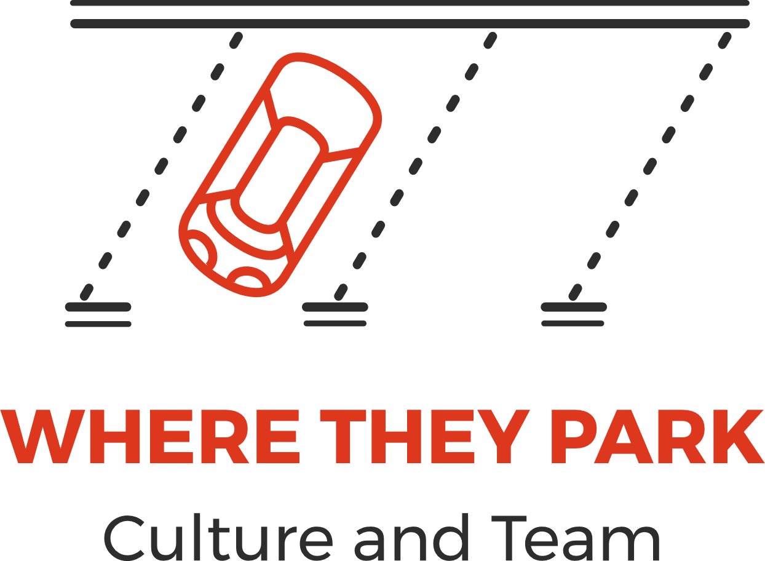
FIVE KEY AREAS OF JOB FIT
The Car Analogy

Slide 34
FIVE KEY AREAS OF JOB FIT
The Car Analogy

Slide 35
INTERVIEW QUESTIONS
Reveal if a Candidate’s Interests Match the Job
What jobs have you enjoyed the most? Why? Please share specific examples of what you enjoyed.
What jobs have you enjoyed the least? Why? Please share specific examples of what you disliked.
Give specific examples of past environments you worked best in.
Give specific examples of past environments that did not work well for you.
What responsibilities would you like to avoid in your next job? Why?
See 30+ Motivator-Related Interview Questions at
www.motivatorsppd.com

Slide 36

Benefits of Understanding Workplace Motivators
Helps to build stronger relationships
Increases appreciation for what is important to others
Helps you to include the viewpoint of others
Allows you to communicate more effectively
Raises satisfaction and fulfillment in work and life
Assists in hiring people that will be engaged in the culture
Supports managers to engage their staff and utilize their passions
Notes:
Objective: To see how understanding Driving Forces will benefit you personally and professionally.
Facilitation:
Read the list and ask participants which benefits would be most valuable to them.
Transition: Now that we see the benefits, let’s get clearer about what the Driving Forces measure.

Slide 37
At a base-level, we wonder…
"What am I here for in this world?
Why do I work for this organization?
How can this organization help me fulfill my meaning in the world?
How can I help this organization help me fulfill my meaning in the world?”
— Dr. Robert S. Hartman, Founder of the Science of Axiology, 1960’s

Slide 38
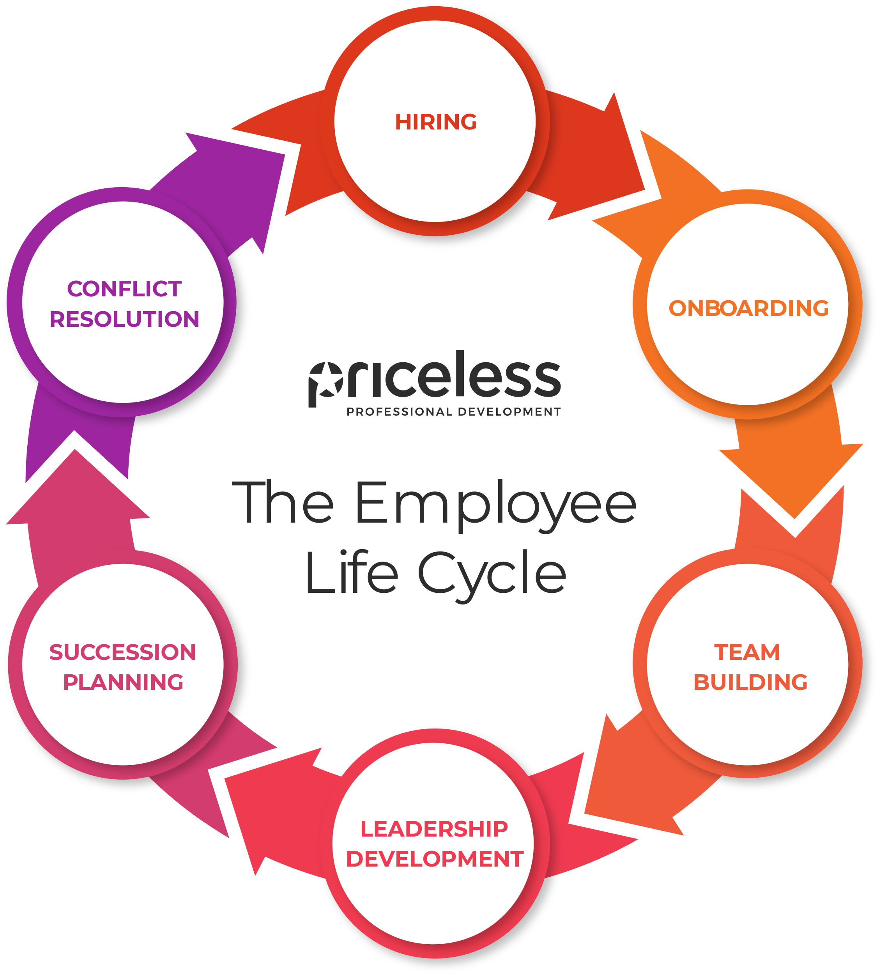
Use motivators insight throughout the entire employee lifecycle.

Slide 39

“Are they going to be happy?
Are they going to be productive?
Will they want to stay?
Will they own their job?
Will they contribute their talents generously?”
— Dr. Robert S. Hartman
Developer of the Science Behind Our Assessments

Slide 40
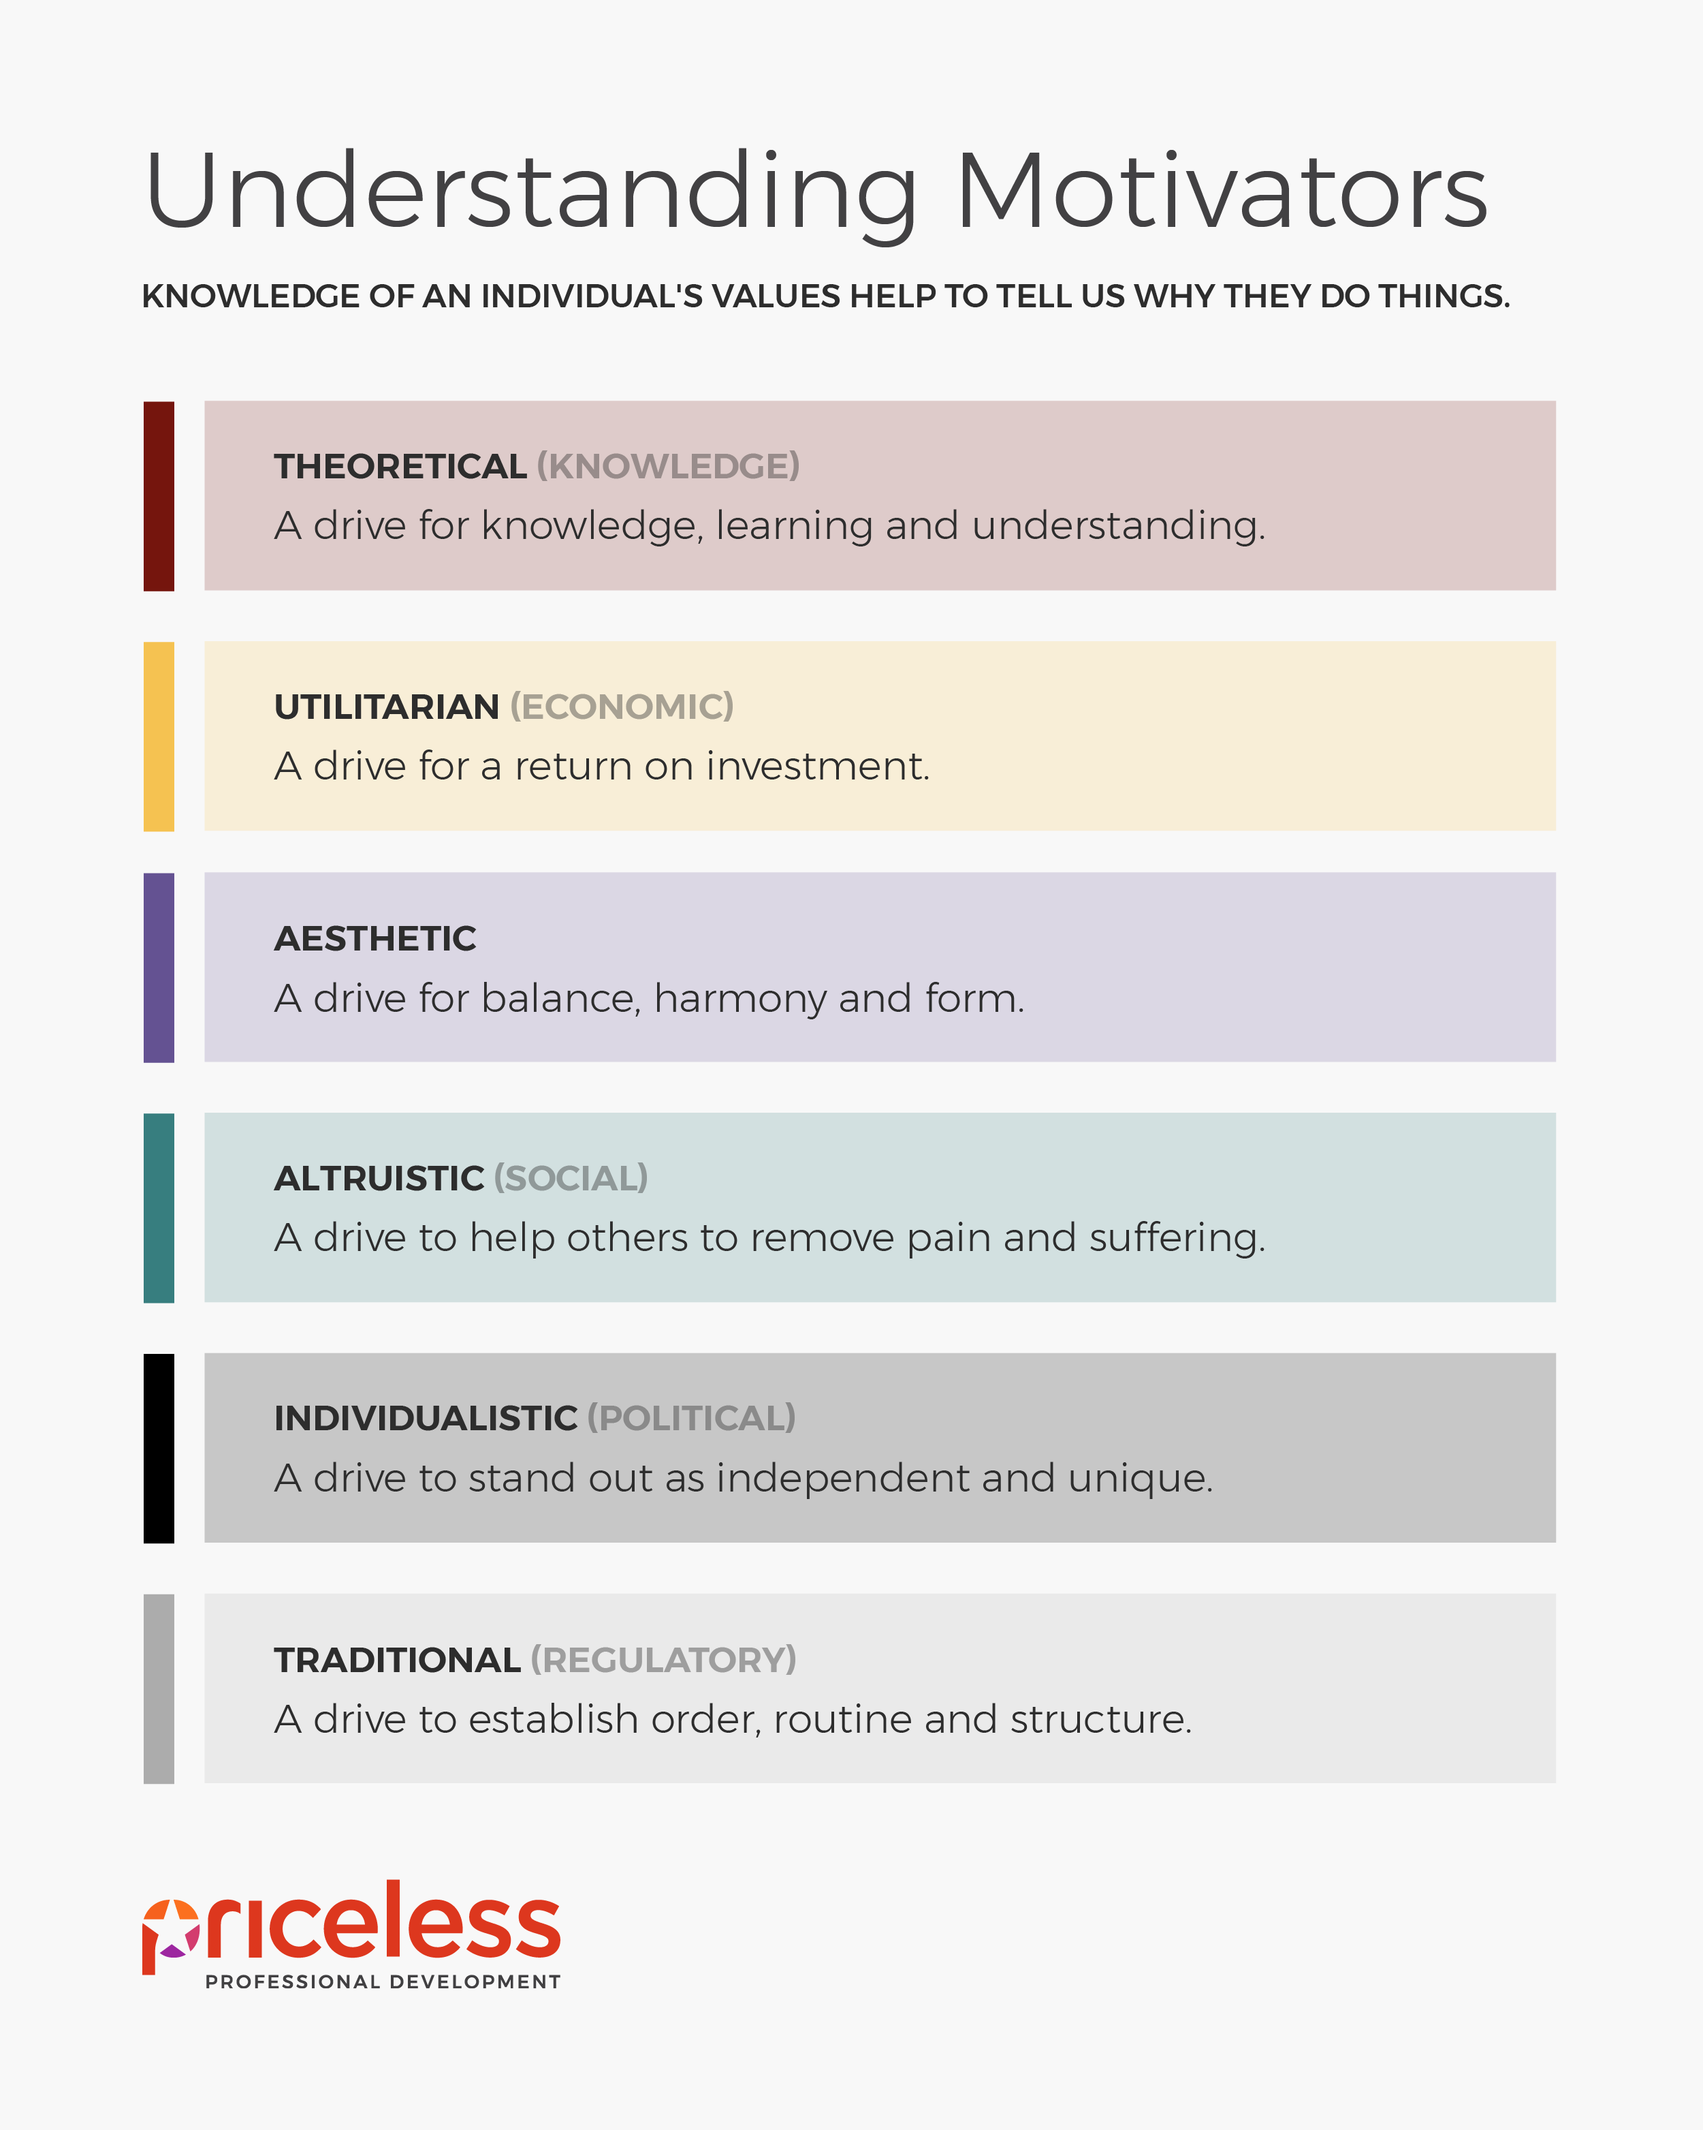
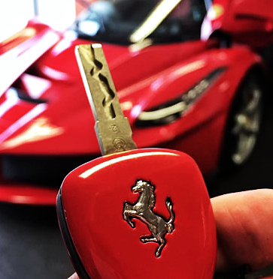

Slide 41
What is normal for you and your team is…
enthusiasm.
laughing a lot, many times a day.
to feel strong, sure, confident, and secure.
to have so much energy at the end of the day that
you're looking for more good things to do.
to have such passion for life that when you're with other people,
you're eager to hear about what they're doing and how they're doing it.
to have so much energy at the end of the day, you’re
already eagerly planning tomorrow.
feeling disappointed that the sun goes down and
enthusiastic that the sun comes up.

Slide 42
Workplace Motivation:
Drive Like a Ferrari with a Full Tank of Gas
WHAT YOU WISH YOU KNEW
Complete the Workplace Motivators Assessment
www.motivatorsppd.com

Slide 43
www.pricelessprofessional.com/ferrari
www.wakeupeagerworkforce.com
www.pricelessprofessional.com/review

