Slide 1
Hiring with TriMetrix - Video Three (of Three)
Notes:
(INTRO) Today we’re going together for a team building tune up!
(WHY HIS MATTERS TO YOU, WHY YOU ARE HAPPY/EXCITED TO BE THERE – SHOW ENERGY)
I’m excited to show you how to better understand your own and teammate’s strengths and potential growth areas.
(EMPOWER – WHAT THEY WILL GET FROM THIS SESSION)
You are going to be able to use this information to learn how to leverage each other’s top talents, cover each other’s blind spots and overall work together more effectively and ENJOY working together, even more!
Our Agenda today will be to review the top motivators and communication style of the team and then review individual and team Strengths and Growth Edges. (Opportunities)

Slide 2
WHO CAN BENEFIT:
For All Levels of TriMetrix Expertise
Don’t Miss: Videos One and Two

Slide 3
WHAT’S COVERED:
Five Areas That Impact Performance
2) How to Conduct a Hiring Manager Debrief Conversation
3) Share Eleven Tools to Accelerate and Deepen Hiring and Interview Expertise

Slide 4
TriMetrix Helps You Focus on Fit…

Slide 5
Five Areas That Impact Performance:
ROADS TRAVELED/FUTURE PLANS
Background, Experience/ Knowledge & Future Goals
HOW WE DRIVE - DISC
Communication & Interaction Style
GAS IN TANK - PIAV
Motivation, Values and Interest in the Work
HORSEPOWER – AXIOLOGY Personal Skills & Acumen
GARAGE/WHERE PARKED
Culture & Team

Slide 6
How to Use the Five Areas of Fit
Five Areas of FIT | Candidate A – Sam | Candidate B - Jane
Roads Traveled Future Travel Plans
Gas In Tank – Motivators
How Drive – DISC
Under the Hood – Personal Skills
Garage/Where Parked Culture & Team and Overall F.I.T.
FIT Questions:
Did not match two Under the Hood Skills and one Gas In Tank area.
FIT Questions:
Review Training Needed

Slide 7
Hiring Manager Debrief Conversation Process:
ASK HIRING MANAGER: What do you like about this candidate? What concerns do you have? REVIEW: The Position Benchmark – The Top Job Priorities and Superior Performance Attributes selected for the role. Candidate matches and potential gaps. Potential level of risk, based upon fit. PROVIDE: Sample interview questions for gap areas if a 2nd interview will be held.

Slide 8
Hiring Manager Debrief Conversation Process:
ASK HIRING MANAGER: What do you like about this candidate? What concerns do you have? REVIEW: The Position Benchmark – The Top Job Priorities and Superior Performance Attributes selected for the role. Candidate matches and potential gaps. Potential level of risk, based upon fit. PROVIDE: Sample interview questions for gap areas if a 2nd interview will be held.

Slide 9
Hiring Manager Debrief Conversation Process:
ASK HIRING MANAGER: What do you like about this candidate? What concerns do you have? REVIEW: The Position Benchmark – The Top Job Priorities and Superior Performance Attributes selected for the role. Candidate matches and potential gaps. Potential level of risk, based upon fit. PROVIDE: Sample interview questions for gap areas if a 2nd interview will be held.

Slide 10
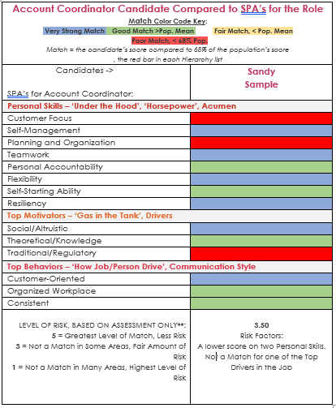
Account Coordinator Priorities:
1. 95% Customer Satisfaction
2. Learn new products within the specified time frame
3. Complete orders and requests according to protocol

Slide 11
Hiring Manager Debrief Conversation Process:
ASK HIRING MANAGER: What do you like about this candidate? What concerns do you have? REVIEW: The Position Benchmark – The Top Job Priorities and Superior Performance Attributes selected for the role. Candidate matches and potential gaps. Potential level of risk, based upon fit. PROVIDE: Sample interview questions for gap areas if a 2nd interview will be held.
“The TriMetrix interview questions are so beneficial – they help me be a better business partner.” Feedback from a HUB Human Resource Leader

Slide 12
Sample Follow Up Interview Questions Candidate Sandy:
Under The Hood : Customer Focus (A commitment to customer satisfaction.)
Give me an example of a time when you knew the customer was wrong, but you had to accommodate their wishes. How did you handle it? What did you say? What did you do? How did you feel about it?
Tell me about a situation where you were able to anticipate a customer's needs before the customer even mentioned what they wanted.
Under The Hood : Planning and Organization (Ability to implement processes and procedures.)
Have you ever faced a day in which you just couldn’t get everything done that you had planned? How did you handle it?
Do you consider yourself to be a good time manager? Share with me the planning system you use and show me how you use it.
Gas In Tank: Traditional/Regulatory (A drive interest in following processes, rules and procedures.)
Is there an absolute right and absolute wrong? How do you decide what is right and what is wrong?
Do you sometimes feel that things would be easier and better if there were fewer rules and procedures? How do you deal with it?

Slide 13
www.pricelessprofessional.com/learningbites

Slide 14
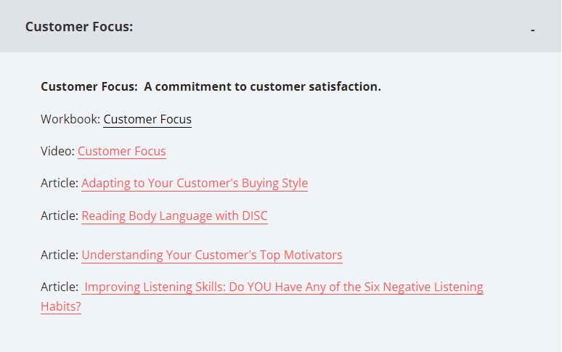
www.pricelessprofessional.com/learningbites

Slide 15
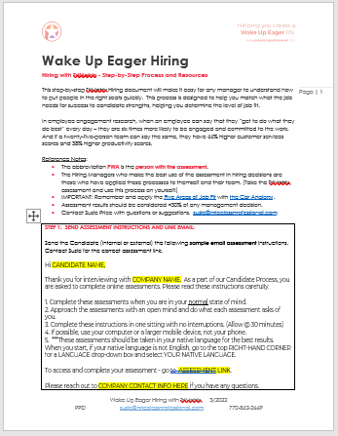
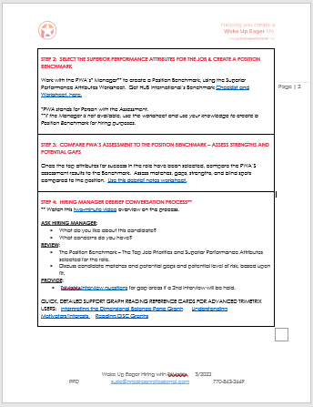
TriMetrix Hiring Reference Document

Slide 16
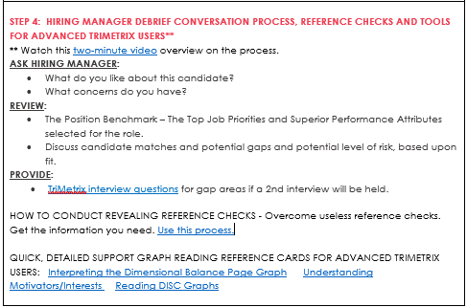
TriMetrix Hiring Reference Document

Slide 17
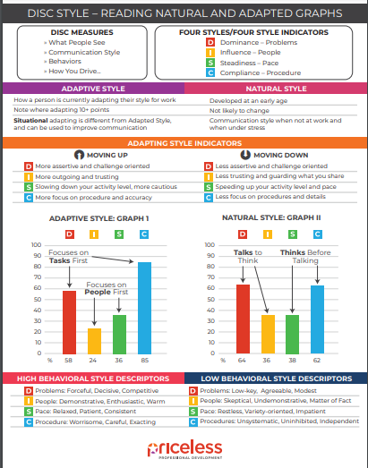
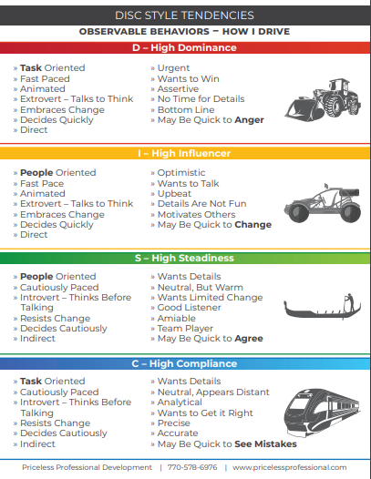
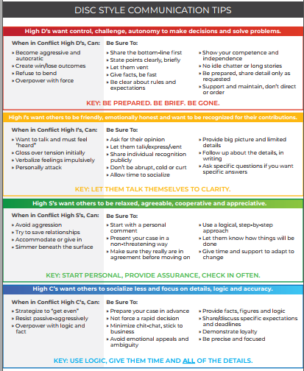
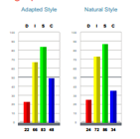
Debriefing the “How We Drive” Graph
READING GRAPHS
STYLE TENDENCIES
COMMUNICATION TIPS

Slide 18
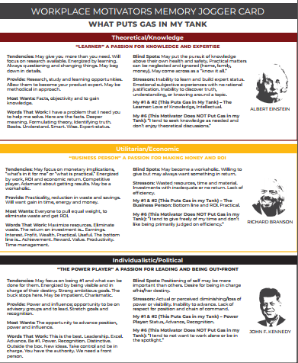
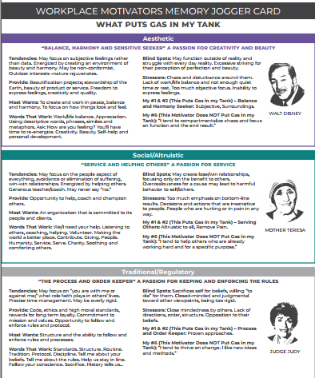
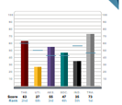
Debriefing the “Gas in Tank” Graph
#1 #2
Gas in Tank
#6
Empty
Tank

Slide 19
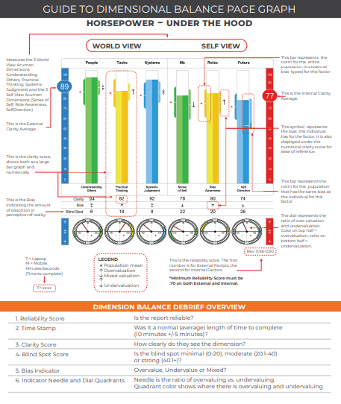
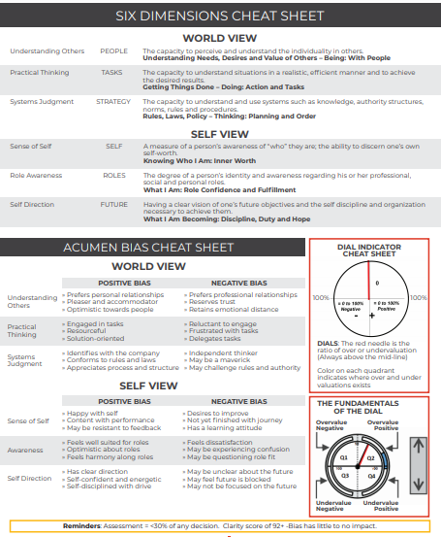
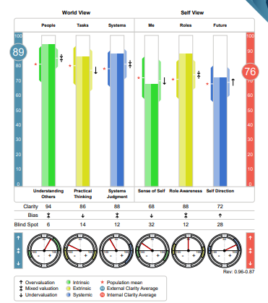
Resources for Debriefing the “Under the Hood” Graph
READING THE GRAPH
SIX DIMENSIONS AND BIAS

Slide 20
Interviewing/Hiring Tools:
Candidate’s TriMetrix Assessment
Superior Performance Attributes Check List and Worksheet
Interview questions for each TriMetrix Area
Short eBook: The Three Biggest Mistakes Interviewers Make https://bit.ly/ThreeInterviewMistakes
PDF Copy: How to Hire Superior Performers: 70 Best Practices https://bit.ly/SeventyHiringTips
Top 13 Interview Mistakes Quiz: www.pricelessprofessional.com/13mistakes
Conducting Revealing Reference Checks
Podcast: www.WakeUpEagerWorkforce.com
eBook
Book
Podcast
Notes:
Will share link to these tools.

Slide 21
TriMetrix Helps You Focus on Fit…

Slide 22
You Must Know:
“Are they going to be happy? Are they going to be productive? Will they want to stay? Will they own their job? Will they contribute their talent generously?”
Dr. Robert S. Hartman
Founder of the Science of Axiology

Slide 23
Five Areas That Impact Performance:
ROADS TRAVELED/FUTURE PLANS
Background, Experience/ Knowledge & Future Goals
HOW WE DRIVE - DISC
Communication & Interaction Style
GAS IN TANK - PIAV
Motivation, Values and Interest in the Work
HORSEPOWER – AXIOLOGY Personal Skills & Acumen
GARAGE/WHERE PARKED
Culture & Team

Slide 24
Hiring with TriMetrix - Video Three (of Three)
Notes:
(INTRO) Today we’re going together for a team building tune up!
(WHY HIS MATTERS TO YOU, WHY YOU ARE HAPPY/EXCITED TO BE THERE – SHOW ENERGY)
I’m excited to show you how to better understand your own and teammate’s strengths and potential growth areas.
(EMPOWER – WHAT THEY WILL GET FROM THIS SESSION)
You are going to be able to use this information to learn how to leverage each other’s top talents, cover each other’s blind spots and overall work together more effectively and ENJOY working together, even more!
Our Agenda today will be to review the top motivators and communication style of the team and then review individual and team Strengths and Growth Edges. (Opportunities)

