Slide 1
Top Advice for Your Younger Self
Show notes: www.pricelessprofessional.com/advice

Slide 2
www.pricelessprofessional.com

Slide 3
www.pricelessprofessional.com/cetififcation

Slide 4
Advice to My Younger Self
2004
2006
2008
2013
2015
Since 2020
2004

Slide 5
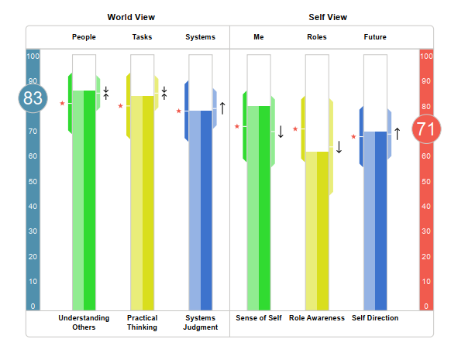
Advice to My Younger Self
MAKE LISTENING AND SEEKING FIRST TO UNDERSTAND - YOUR SUPERPOWERS.
WORLD VIEW: Understanding Others
Practical Thinking
Systems Judgment
SELF VIEW: Sense of Self
Role Awareness
Self Direction
HORSEPOWER – AXIOLOGY Personal Skills & Acumen

Slide 6
Advice to My Younger Self
MAKE LISTENING AND SEEKING FIRST TO UNDERSTAND - YOUR SUPERPOWERS.
WORLD VIEW:
Understanding Others
Practical Thinking
Systems Judgment
SELF VIEW: Sense of Self
Role Awareness
Self Direction

Slide 7
Advice to My Younger Self
MAKE LISTENING AND SEEKING FIRST TO UNDERSTAND - YOUR SUPERPOWERS.
FIGURE OUT HOW TO GET THINGS DONE.
WORLD VIEW: Understanding Others
Practical Thinking
Systems Judgment
SELF VIEW: Sense of Self
Role Awareness
Self Direction

Slide 8
Advice to My Younger Self
MAKE LISTENING AND SEEKING FIRST TO UNDERSTAND - YOUR SUPERPOWERS.
FIGURE OUT HOW TO GET THINGS DONE.
LEARN FROM OTHERS BUT LISTEN TO YOUR INNER KNOWING MORE.
WORLD VIEW: Understanding Others
Practical Thinking
Systems Judgment
SELF VIEW: Sense of Self
Role Awareness
Self Direction

Slide 9
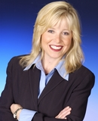
Advice to My Younger Self
MAKE LISTENING AND SEEKING FIRST TO UNDERSTAND - YOUR SUPERPOWERS.
FIGURE OUT HOW TO GET THINGS DONE.
LEARN FROM OTHERS BUT LISTEN TO YOUR INNER KNOWING MORE.
2004

Slide 10
Make Listening and Seeking First to Understand – Your Superpowers
Acumen > Drivers > DISC
Talk Less, Listen More
www.pricelessprofessional.com/weapon

Slide 11
Make Listening and Seeking First to Understand – Your Superpowers
Purpose | Why are you holding this session? What are the key objectives? Why does this matter now?
Product | What do you want to have produced once we are done? How will we know that we are successful? (Measures of Success)
Participants | Who needs to be involved, and what are their perspectives?
Probable Issues | What are concerns that will likely arise? What are the gotcha’s that could prevent us from achieving the purpose?
Process | What steps should we take to achieve the purpose and desired outcome? How do we overcome some of the probable issues we will face?
Talk Less, Listen More
Get the Five P’s++ before moving forward.
++ALSO ASK++
What is your budget for this project?
When do you want to start?
What are your key decision-making criteria?
What could stop us from working together? Are you talking to anyone else? Michael Wilkinson, Secrets of Facilitation Alan Weiss, Million Dollar Consulting

Slide 12
Make Listening and Seeking First to Understand – Your Superpowers
ITEMS YOUR FOLLOW UP SHOULD INCLUDE:
Objectives, Measures of Success, Value to the Company.
Short Methodology. Timing.
Good, Better, Best Options to select.
Joint and Individual Accountabilities.
Talk Less, Listen More
Get the Five P’s++ before moving forward.
In your proposal, share their answers back with them.

Slide 13
Make Listening and Seeking First to Understand – Your Superpowers
I > E > S
People > Doing > Ideas
Connection before precision.
Talk Less, Listen More
Get the Five P’s++ before moving forward.
In your proposal, share their answers back with them.
Grow all three but keep things in the right order.
WORLD VIEW: Understanding Others
Practical Thinking
Systems Judgment
SELF VIEW: Sense of Self
Role Awareness
Self Direction

Slide 14
Make Listening and Seeking First to Understand – Your Superpowers
Talk Less, Listen More
Get the Five P’s++ before moving forward.
In your proposal, share their answers back with them.
Grow all three but keep things in the right order.

Slide 15
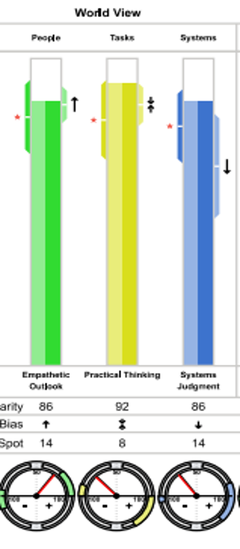
Advice to My Younger Self
WORLD VIEW:
Understanding Others
Practical Thinking
Systems Judgment
MAKE LISTENING AND SEEKING FIRST TO UNDERSTAND - YOUR SUPERPOWERS.
FIGURE OUT HOW TO GET THINGS DONE.
LEARN FROM OTHERS BUT LISTEN TO YOUR INNER KNOWING MORE.

Slide 16
Figure Out How to Get Things Done
I get things done immediately, thoroughly, and cheerfully.
http://getitdoneapp.com/
**MOST IMPORTANT** My Daily List of Six…

Slide 17
Figure Out How to Get Things Done
Give Masterful Directions
P.e.D.e.Q.s.
P. Purpose of the activity
e. Share a simple example outside the topic area that helps participants understand how to complete the activity.
D. Give general directions using verbal pictures and gestures
e. Explain specific exceptions
Q. “Are there any questions?”
s. Ask a starting question that gets them visualizing the answers
Michael Wilkinson, Secrets of Facilitation
I get things done immediately, thoroughly, and cheerfully.
Become a great Facilitator.

Slide 18
Figure Out How to Get Things Done
I get things done immediately, thoroughly, and cheerfully.
Become a great Facilitator.
Ask Amazing Starting Questions:
“The first thing we want to talk about is inputs. What are the inputs to the scheduling process?
MOVE FROM THE ABOVE TO THIS:
**“If you were to develop the school schedule, what information would you need to have close by?”
1.Build an image… “Think about…” “Imagine…” “Consider…”
2. Extend the image… set up an image that encourages participants to visualize
3. Ask the question
Michael Wilkinson, Secrets of Facilitation

Slide 19
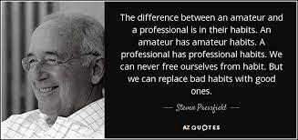
Figure Out How to Get Things Done
I get things done immediately, thoroughly, and cheerfully.
Become a great Facilitator.
Give them more than they expect.

Slide 20
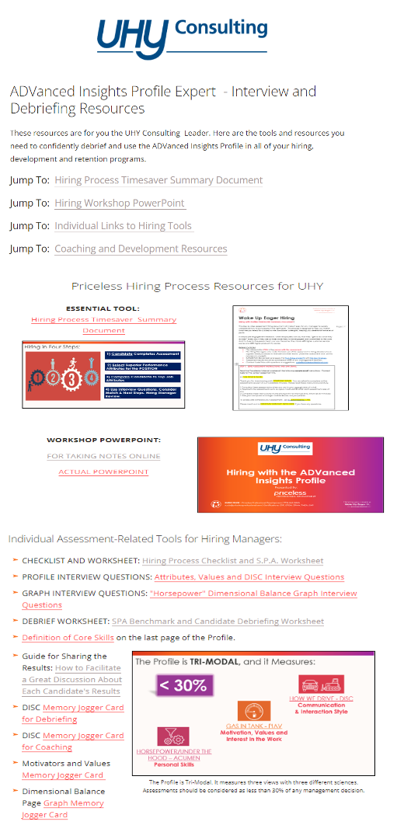
Figure Out How to Get Things Done
ABC COMPANY
I get things done immediately, thoroughly, and cheerfully.
Become a great Facilitator.
Give them more than they expect.

Slide 21
Figure Out How to Get Things Done
I get things done immediately, thoroughly, and cheerfully.
Become a great Facilitator.
Give them more than they expect.
“You can’t assert interest and openness, but you can create it. Put yourself in their shoes and determine what you can do to reduce resistance.”
Suzie Price

Slide 22
Figure Out How to Get Things Done
I get things done immediately, thoroughly, and cheerfully.
Become a great Facilitator.
Give them more than they expect.
People > Action > Ideas

Slide 23
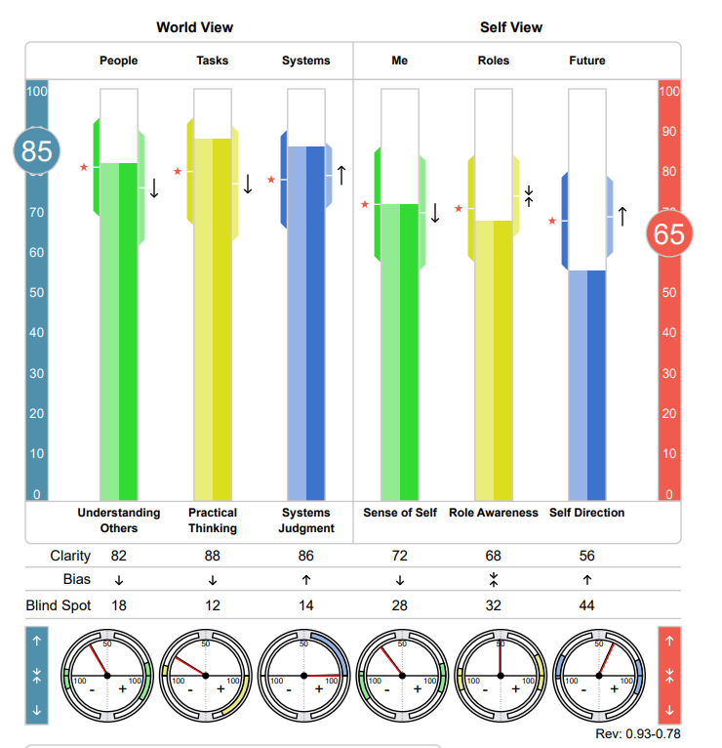
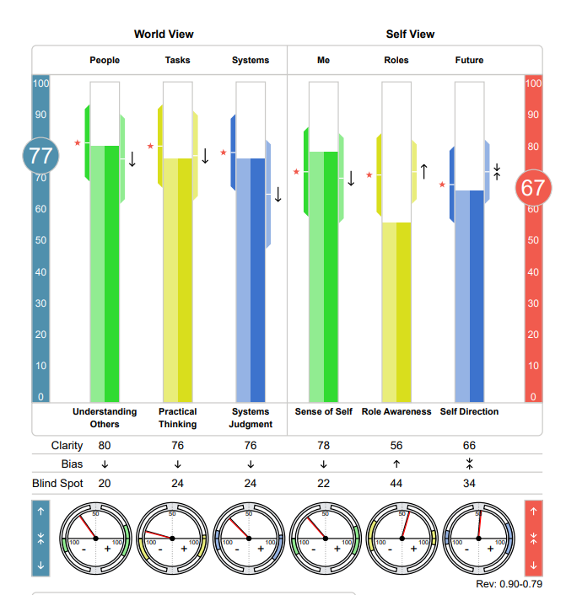
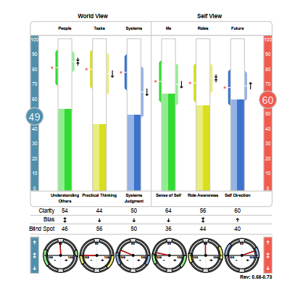
Figure Out How to Get Things Done
People > Action > Ideas
I get things done immediately, thoroughly, and cheerfully.
Become a great Facilitator.
Give them more than they expect.
There is beauty in every graph. Look for it.
This is someone’s life.
Do no harm.

Slide 24
Figure Out How to Get Things Done
PPD Coaching Debrief Conversation Process
START:
Tell me about how you got where you are today.
What do people tell you are your greatest strengths?
What are one or two growth edges important to you now?
REVIEW ASSESSMENT
Answer questions. Point out strengths. Review insights that relate to the “growth edge” they shared.
PROVIDE DEVELOPMENT RESOURCES:
Determine the next steps.
I get things done immediately, thoroughly, and cheerfully.
Become a great Facilitator.
Give them more than they expect.
There is beauty in every graph. Look for it.
Acumen > Drivers > DISC

Slide 25
Figure Out How to Get Things Done
I get things done immediately, thoroughly, and cheerfully.
Become a great Facilitator.
Give them more than they expect.
There is beauty in every graph. Look for it.
WORLD VIEW:
Understanding Others
Practical Thinking
Systems Judgment

Slide 26
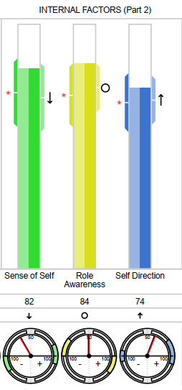
Advice to My Younger Self
MAKE LISTENING AND SEEKING FIRST TO UNDERSTAND - YOUR SUPERPOWERS.
FIGURE OUT HOW TO GET THINGS DONE.
LEARN FROM OTHERS BUT LISTEN TO YOUR INNER KNOWING MORE.
SELF VIEW: Sense of Self
Role Awareness
Self Direction

Slide 27
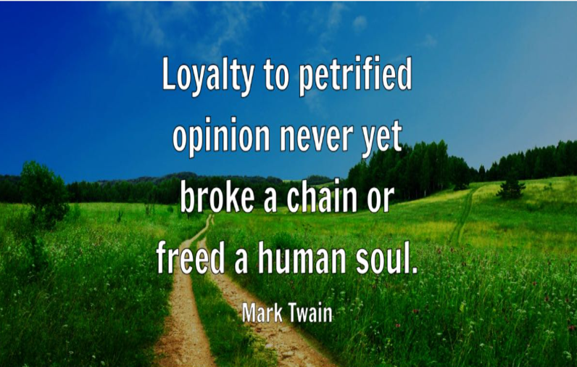
Learn From Others But Listen To Your Inner Knowing More
Everyone has a lot of opinions!

Slide 28
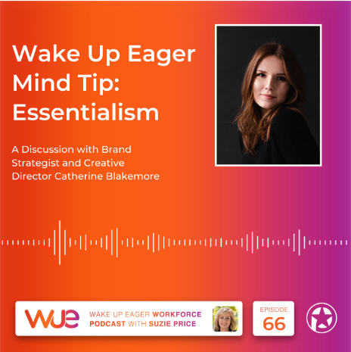
Learn From Others But Listen To Your Inner Knowing More
1) If I could be truly excellent at one thing, what would it be?
2) Is this the most important thing I should do with my time and resources right now?
Everyone has a lot of opinions!
Learn to say no to everything but the essential.
www.pricelessprofessional.com/essentialism

Slide 29
Learn From Others But Listen To Your Inner Knowing More
Consultants have many opinions!
Learn to say no to everything but the essential.
Grow your Self View.
SELF VIEW: Sense of Self
Role Awareness
Self Direction

Slide 30
Learn From Others But Listen To Your Inner Knowing More
Consultants have many opinions!
Learn to say no to everything but the essential.
Grow your Self View.
DAILY TUNE-IN TIME: 1% a day =15 minutes a day 1 hour and 45 minutes a week 91 hours in a year

Slide 31
Advice to My Younger Self
MAKE LISTENING AND SEEKING FIRST TO UNDERSTAND - YOUR SUPERPOWERS.
FIGURE OUT HOW TO GET THINGS DONE.
LEARN FROM OTHERS BUT LISTEN TO YOUR INNER KNOWING MORE.
2004

Slide 33
Top Advice for Your Younger Self
Show notes: www.pricelessprofessional.com/advice

